Slide 1

MBSD Lecture 0
Overview

Slide 2
Course Goals
Present and emphasize MBSD approach
Simple models
Complex system
Basic control
Iterative refinement
Utilize simulation tools
Matlab
Simulink
Stateflow
Notes:
Needs update

Slide 3
Course Outline
Simple Series Electric Vehicle
Model hierarchy
Ideal Component Models
Controls
Improved Component Models
Inefficiencies
Experimental Data
Improved Controls
Notes:
Needs update

Slide 4
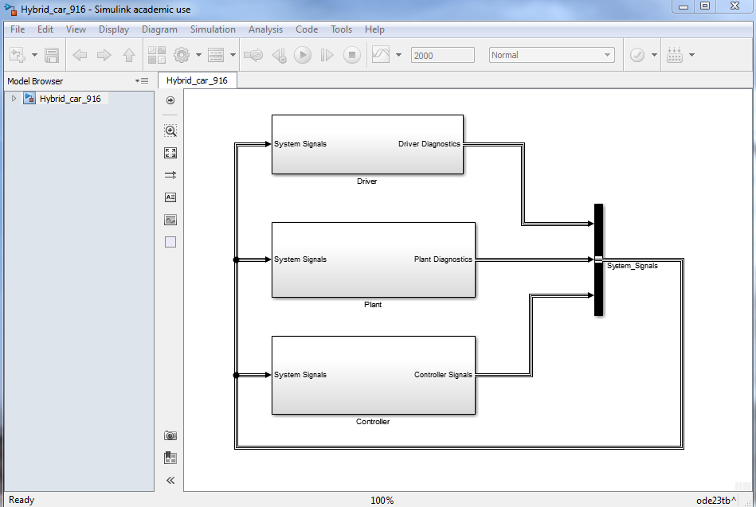
Model Overview - System
Driver
CAN Bus
Plant
Controller
Notes:
Needs update

Slide 5
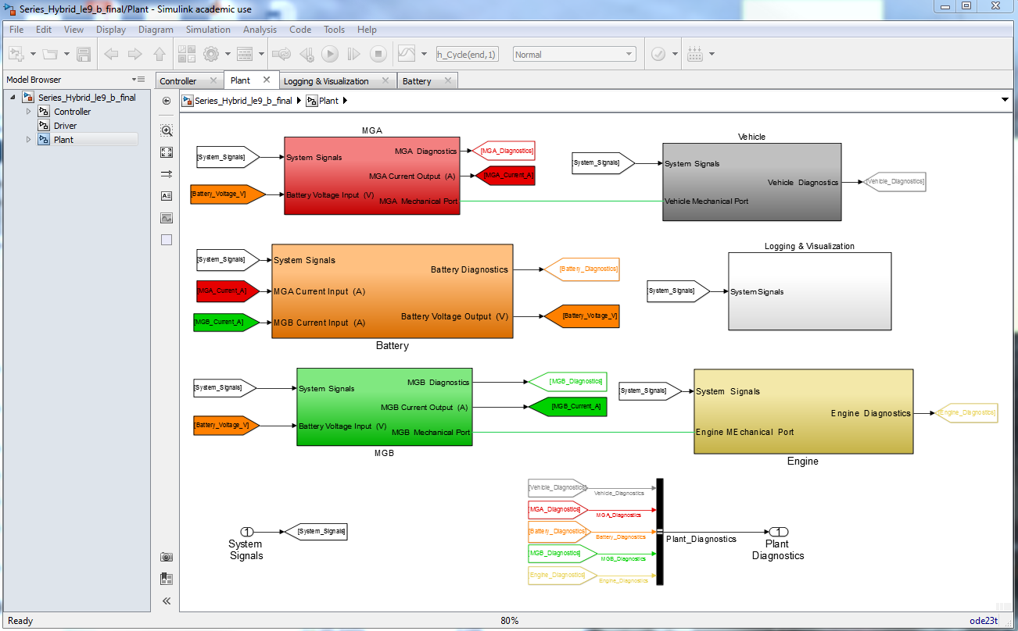
Model Overview - Plant
MGA
Battery
Vehicle Solver
Data Logging
MGB
Engine
System Components
Notes:
Needs update

Slide 6
Model Overview - Plant
Mechanical shaft
Mechanical shaft
Notes:
Needs update

Slide 7
Model Overview - Plant
Electrical Connections
Notes:
Needs update

Slide 8
Model Overview - Plant
Network Connections - CAN
Notes:
Needs update

Slide 9
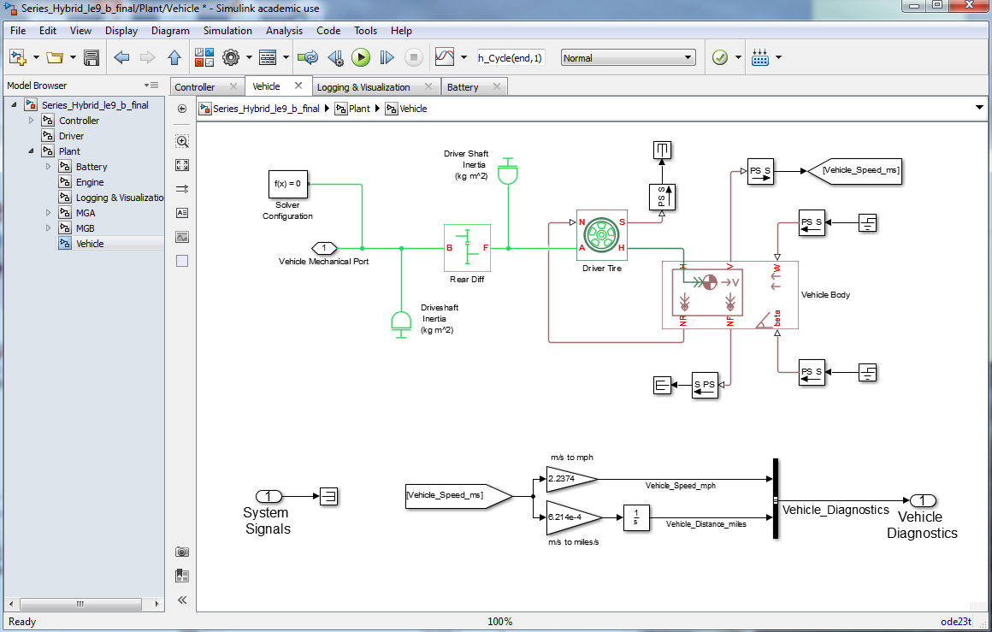
Model Overview - Vehicle
Angular Momentum
Linear Momentum
Notes:
Needs update

Slide 10
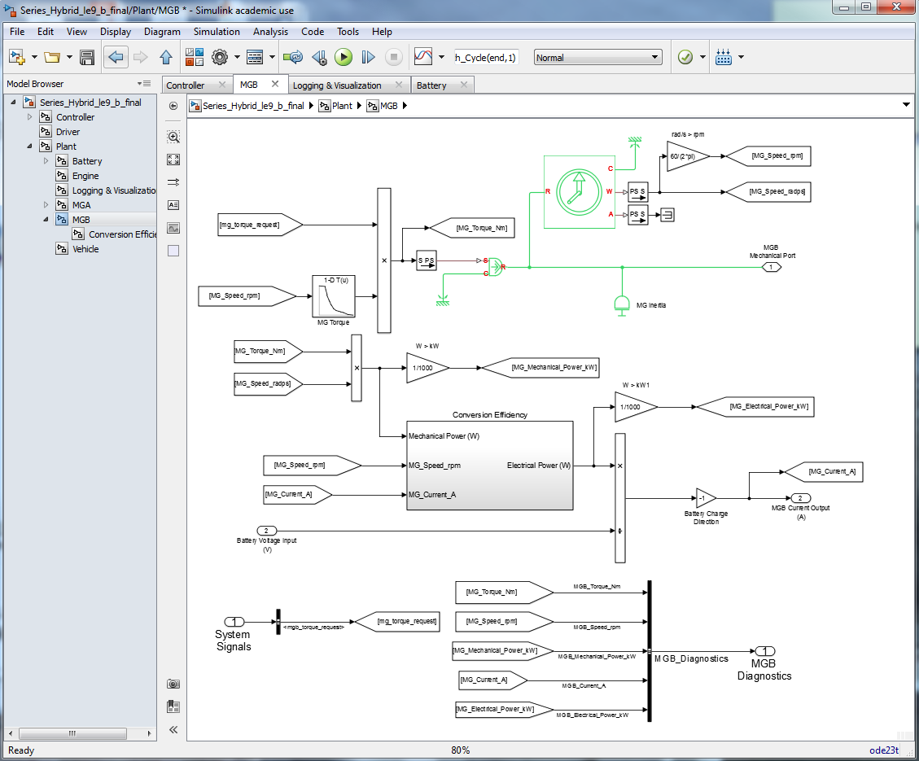
Model Overview - MG
Torque Data
Conversion Efficiency Data
Notes:
Needs update

Slide 11
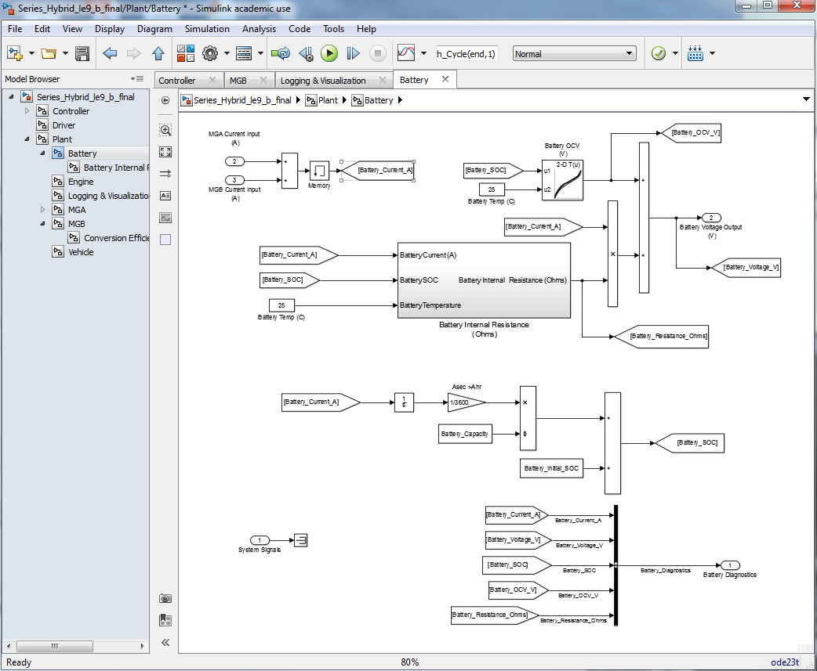
Model Overview – Battery
OCV Data
Conversion Efficiency Data
State of Charge
Notes:
Needs update

Slide 12
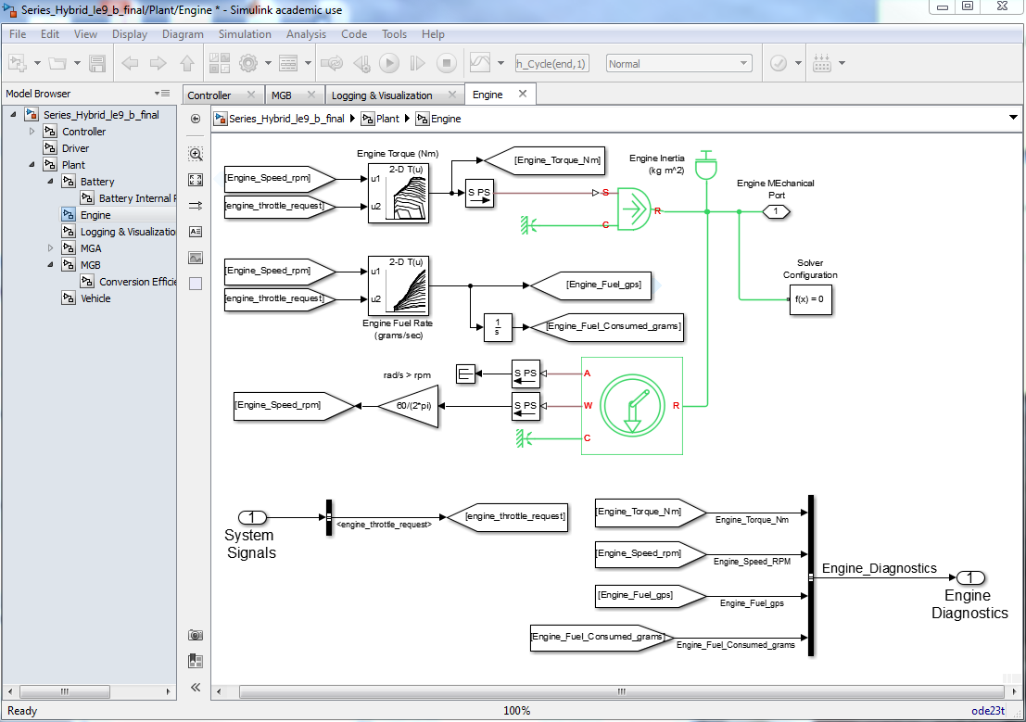
Model Overview - Engine
Torque Data
Fuel Consumption Data
Notes:
Needs update

Slide 13
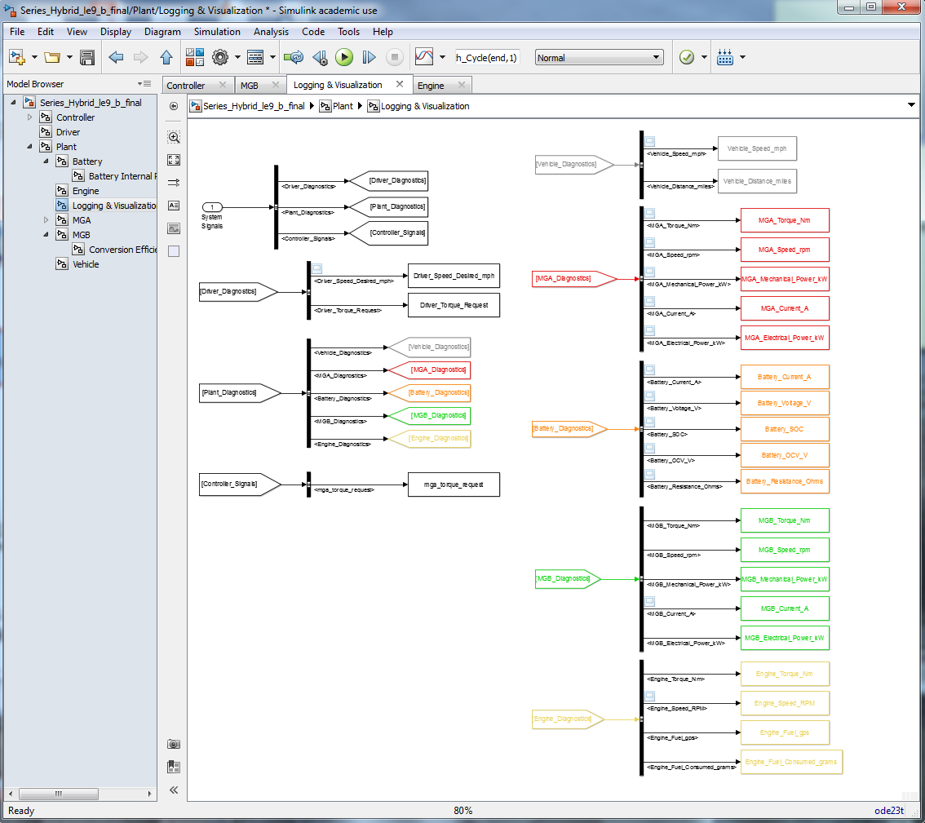
Model Overview - Logging
Plotted Data
Logged Data
Notes:
Needs update

Slide 14
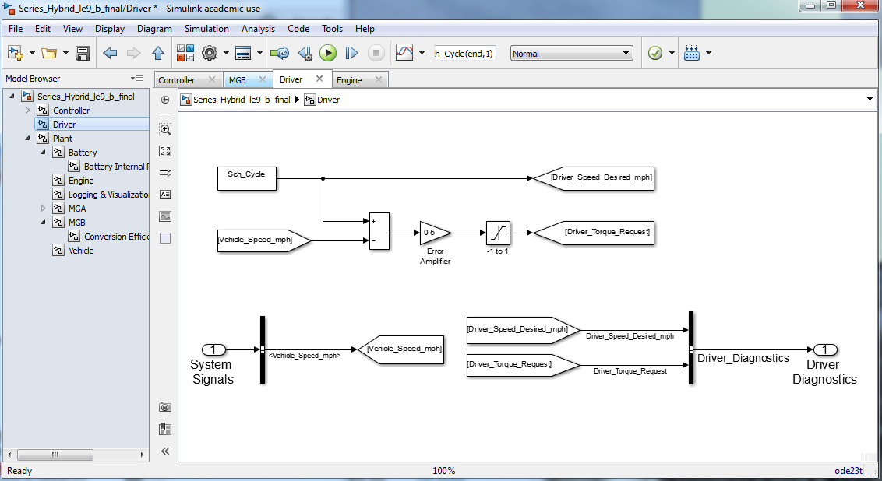
Model Overview - Driver
Speed Trace
Notes:
Needs update

Slide 15
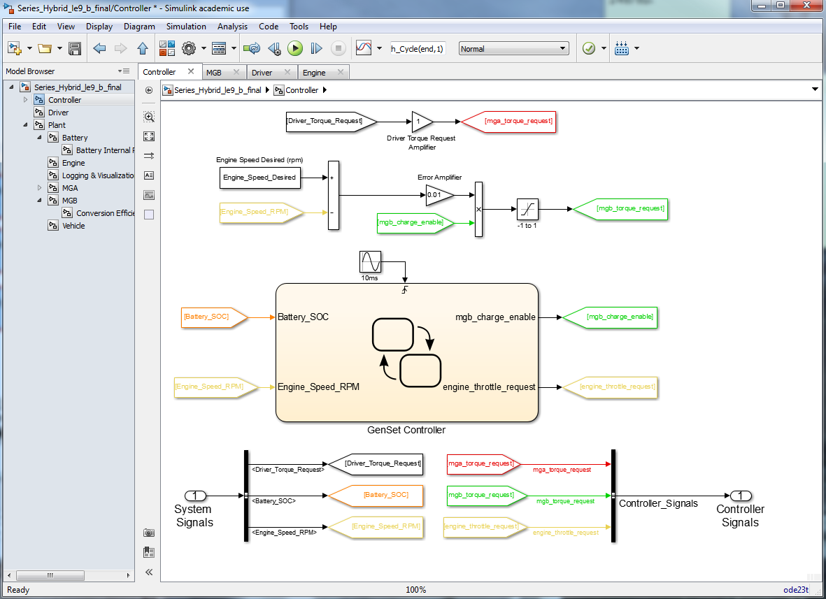
Model Overview - Controller
Powertrain Torque Request
Engine Speed control
Battery Charge Logic
Notes:
Needs update

Slide 16
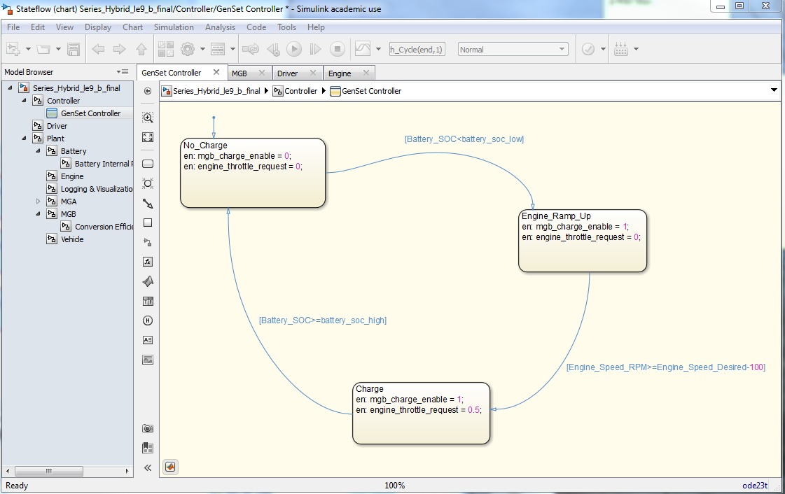
Model Overview - GentSet
Notes:
Needs update

Slide 17
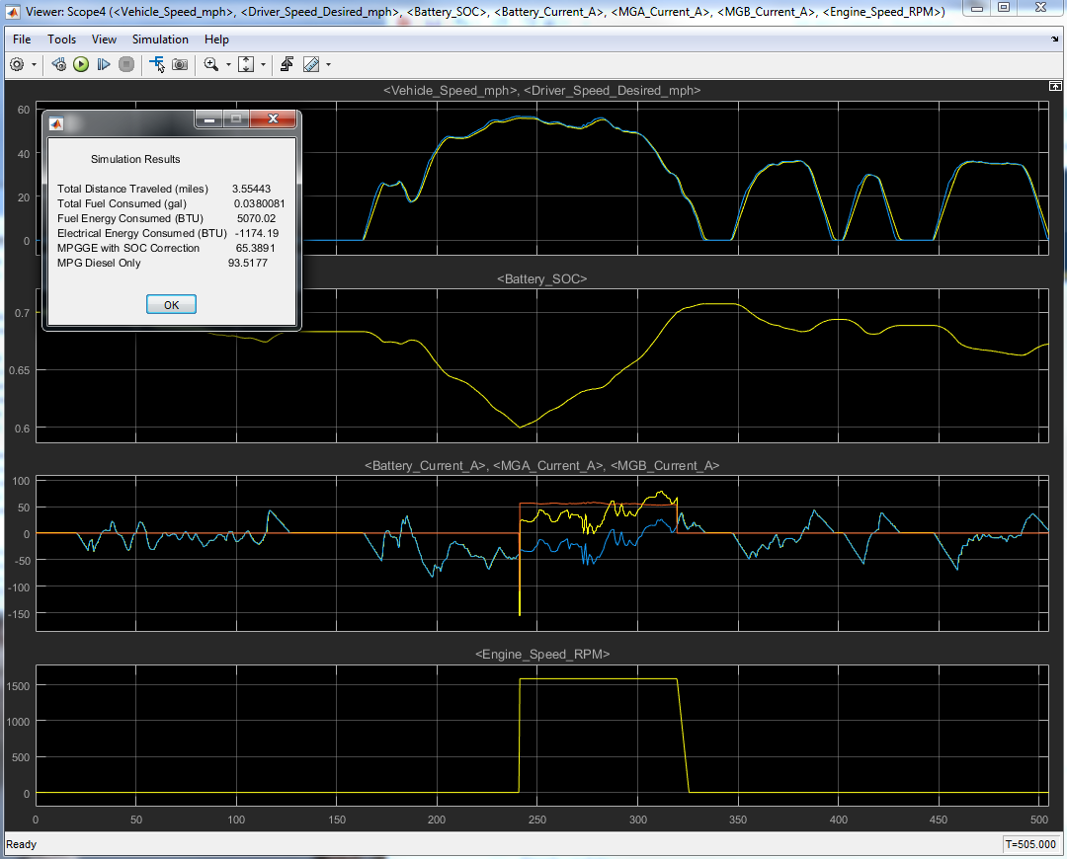
Results
Vehicle Speed
Battery SOC
Currents
Engine Speed
Notes:
Needs update

Slide 18
MBSD Lecture 1
Getting Started with the High Level System

Slide 19
Lecture Goals
Getting Started with Simulink
Developing model hierarchy (subsystems)
Establishing CAN bus
Notes:
Needs update

Slide 20
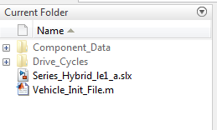
Getting Started
Start Matlab
Make sure you are in the correct directory
Type simulink in the command window
Notes:
Needs update

Slide 21
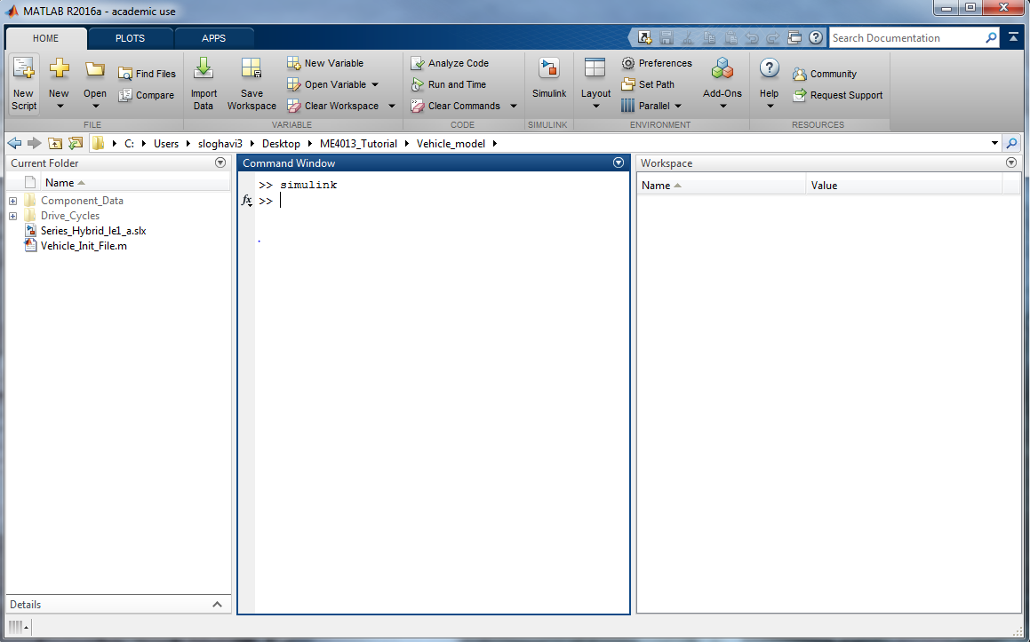
Getting Started
Instead of typing Simulink in the command directly you can select this button
This button allows you to choose the directory
Make sure all files and folders exist in your directory
Notes:
Needs update

Slide 22
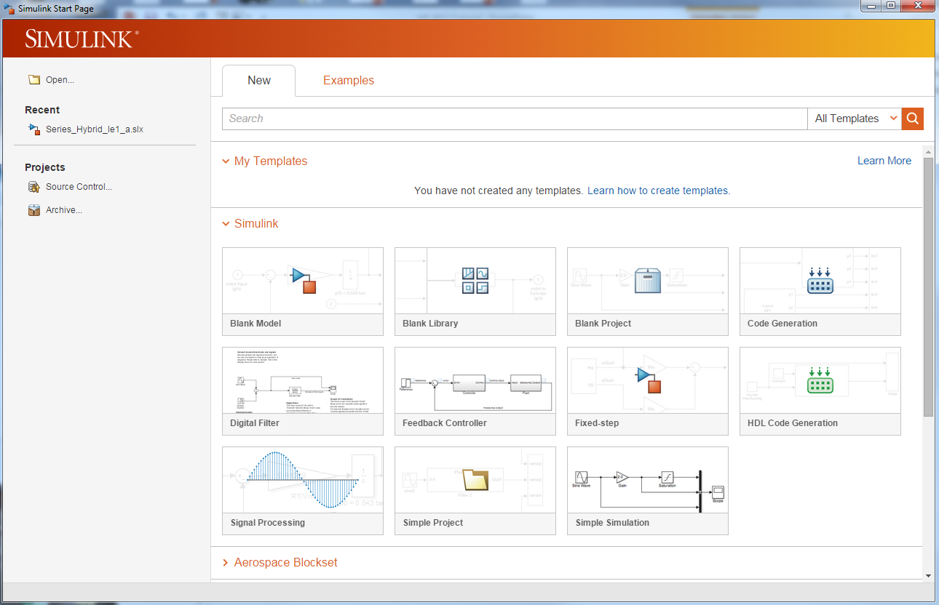
Getting Started
Select Blank model
Notes:
Needs update

Slide 23
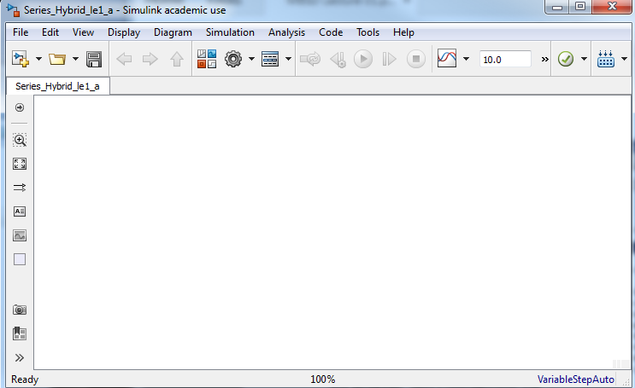
Getting Started
Simulink is a graphical programming environment which enables you to link function blocks to create simulations
In the Simulink model window, select library browser
Library Browser
Notes:
Needs update

Slide 24
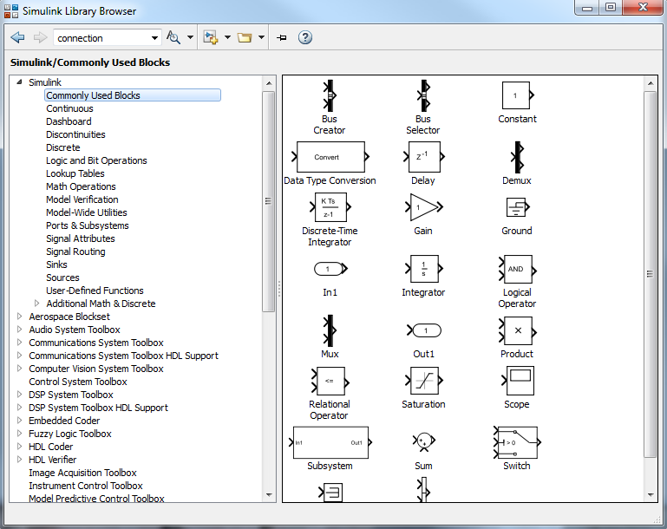
Getting Started
Get yourself familiar with the libraries and blocks in the library browser
Library
Block
Notes:
Needs update

Slide 25
Getting Started
We will primarily use the following libraries
Simulink \ Commonly Used Blocks
Simulink \ Signal Routing
Simulink \ Lookup Tables
Simulink \ Sinks
Simulink \ Sources
Simscape \ Driveline
Stateflow
Notes:
Needs update

Slide 26
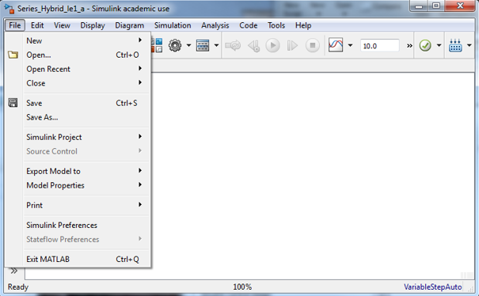
Getting Started
Save the Simulink model as :
Series_Hybrid_le1_a
Do not use spaces or variable names in file names
Notes:
Needs update

Slide 27
High Level Model
We will first create the high level plant and controller model
From
Simulink \ Commonly Used Blocks
Drag three Subsystem blocks into the model
Driver block
Controller block
Vehicle block
Notes:
Needs update

Slide 28
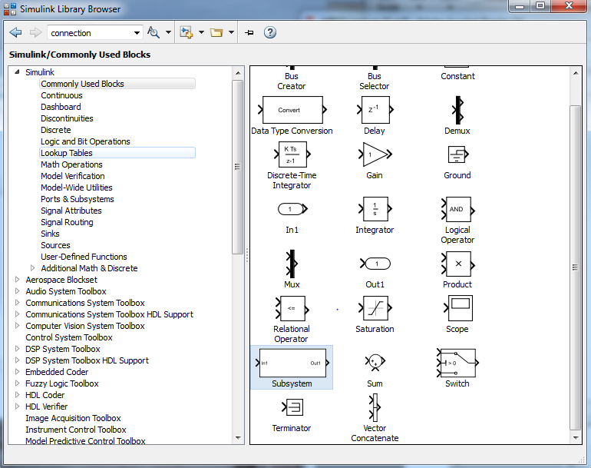
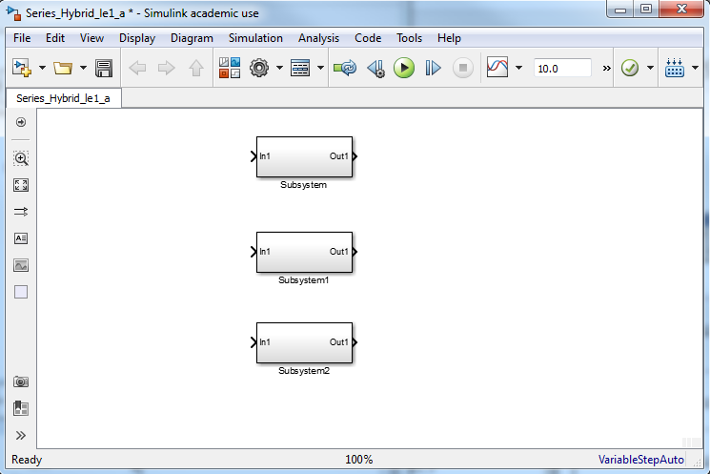
High Level Model
Notes:
Needs update

Slide 29
High Level Model
Rename the upper subsystem
Driver
The middle subsystem
Plant
The lower subsystem
Controller
Notes:
Needs update

Slide 30
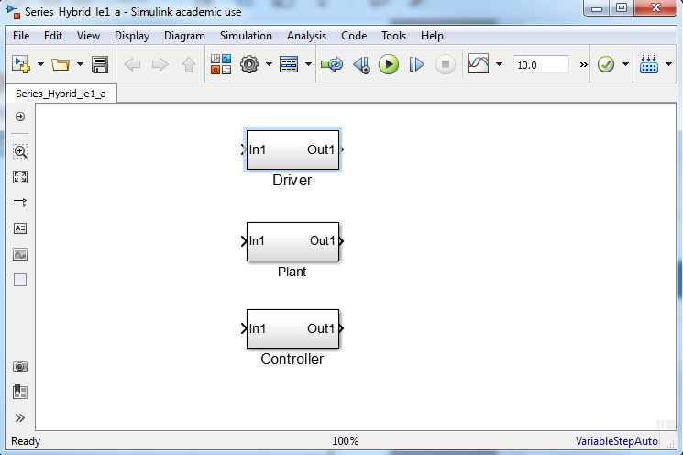
High Level Model
You can change the font size by right clicking on each subsystem/Format/Font Style…
Notes:
Needs update

Slide 31
High Level Model
At this high level, signals will be sent out by the Driver, Plant, and Controller
Driver Torque Request
Battery State of Charge
Engine Throttle Request
These signals will be put onto a common bus so that all three subsystems can receive all signals
Only desired signals will be selected
Notes:
Needs update

Slide 32
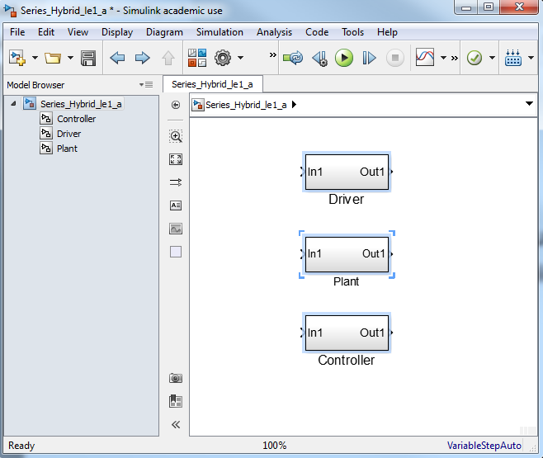
High Level Model
Open Model Browser by selecting the arrow
Shows an outline form of the model
Notes:
Needs update

Slide 33
Driver Subsystem
The Driver receives information
Speedometer
Tachometer
Idiot lights (engine hot, …..)
The Driver sends information
Torque request (gas/brake pedal position)
Gear selection
Notes:
Needs update

Slide 34
Driver Subsystem
Open the Driver subsystem by:
clicking on Driver in Model Browser or
double click on the Driver block
Delete the wire that connects the In1 block to out1 block
Rename
In1 to System Signals
Out1 to Driver Diagnostics
Notes:
Needs update

Slide 35
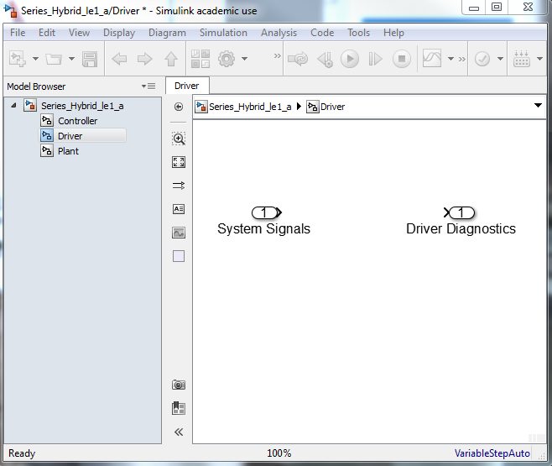
Driver Subsystem
The asterisk indicates that the file has not been saved – save file before running the simulation
It is okay to have spaces and returns in labels
Notes:
Needs update

Slide 36
Driver Subsystem - CAN
From
Simulink \ Commonly Used Blocks
Drag in a Bus Selector and a Bus Creator
The Bus Creator puts signals on the bus
The Bus Selector extracts them from the bus
Connect the System Signals input to the Bus Selector
Connect the Driver Signals input to the Bus Creator
Notes:
Needs update

Slide 37
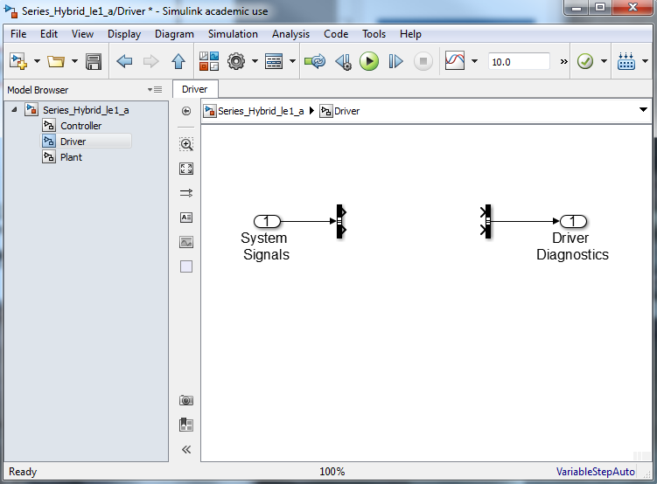
Driver Subsystem - CAN
Bus Selector
Bus Creator
Notes:
Needs update

Slide 38
Driver Subsystem - CAN
For now, the Driver is not going to do anything
From
Simulink \ Commonly Used Blocks
Drag in two Terminators and two Grounds
Connect the two outputs of the Bus Selector to the Terminators
Connect the two inputs of the Bus Selector to the Grounds
Notes:
Needs update

Slide 39
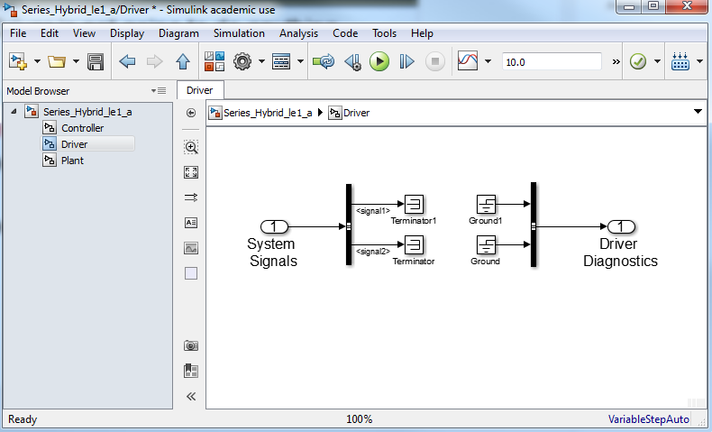
Driver Subsystem - CAN
Name of the signal from the bus selector – currently no signal is attributed to each port. We will later assign a signal to one
Notes:
Needs update

Slide 40
Driver Subsystem - CAN
The symbols for the ground and terminator are pretty obvious – there is no need for them to be labeled
On one of the Terminators
Right Click
Select Format
Deselect Show Block Name
We will do this for many of the blocks
Hide the name of all terminator and ground blocks
Notes:
Needs update

Slide 41
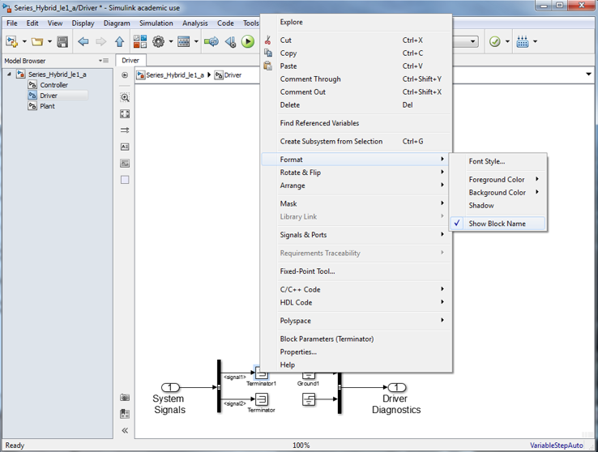
Driver Subsystem - CAN
Notes:
Needs update

Slide 42
Driver Subsystem - CAN
While no signals are being sent by the Driver, the Driver Diagnostics signal should be identified on the bus
On the wire connecting the Bus Creator to the Driver Diagnostics output
Right Click
Select Properties
For the Signal name enter Driver_Diagnostics
Click OK
Notes:
Needs update

Slide 43
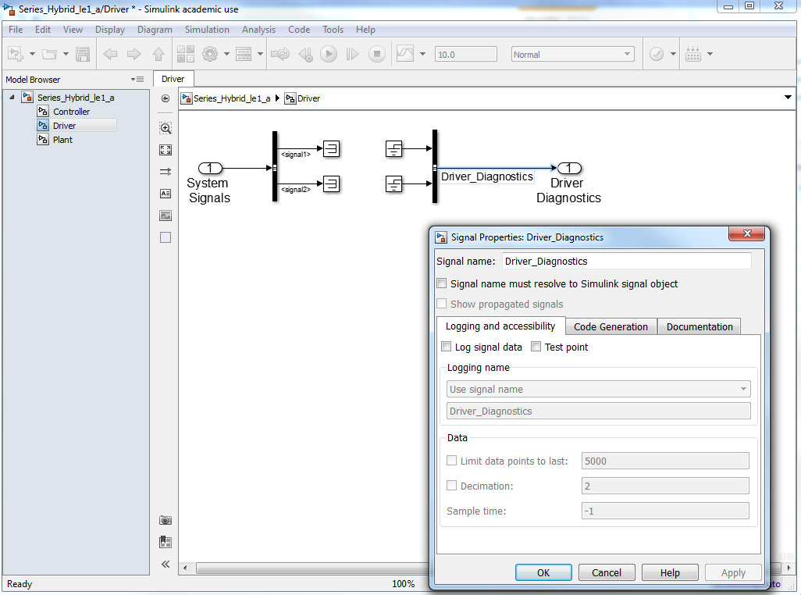
Driver Subsystem - CAN
Notes:
Needs update

Slide 44
Driver Subsystem - CAN
Move the blocks around, enlarge if necessary, and make things look nice
Notes:
Needs update

Slide 45
Controller Subsystem
For now, the controller is not going to do anything
Repeat everything done to the Driver subsystem for the Controller subsystem
Rename the Out1 to Controller Signals
Rename the CAN signal to Controller_Signals
Notes:
Needs update

Slide 46
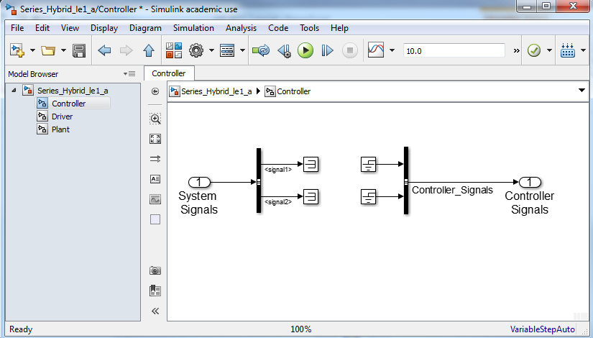
Controller Subsystem
Notes:
Needs update

Slide 47
Plant Subsystem
For now, the Plant is not going to do anything
Repeat everything done to the Controller subsystem for the Plant subsystem
Rename the Out1 to Plant Diagnostics
Rename the CAN signal to Plant_Diagnostics
Notes:
Needs update

Slide 48
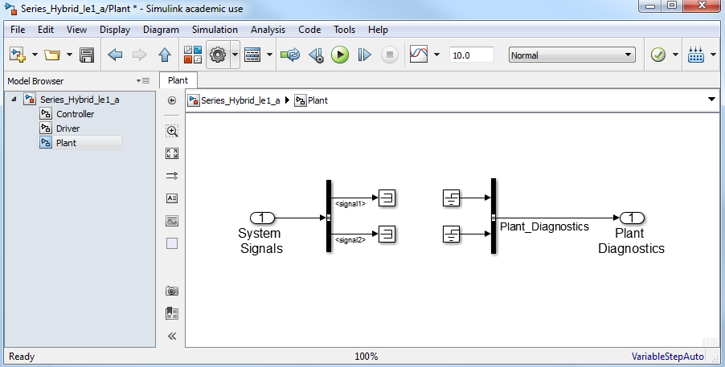
Plant Subsystem
Notes:
Needs update

Slide 49
High Level
Return to the top level of the model
Increase the size of the subsystems to make them legible
Drag in a Bus Creator
Double click of the Bus Creator
Change the number of inputs to 3
Click OK
Connect each subsystem to the Bus Creator
If you Double click on the Bus Creator after connecting the subsystem you can view the input signals
Notes:
Needs update

Slide 50
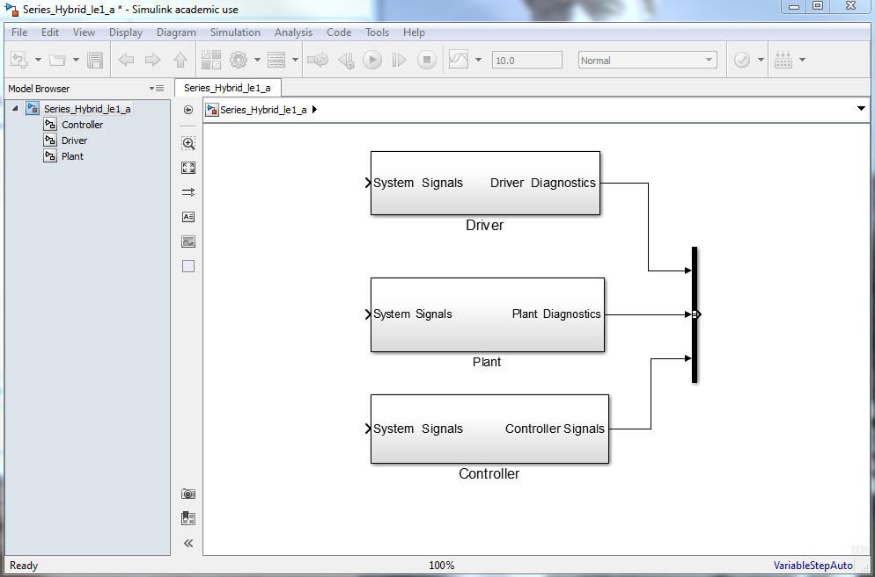
High Level
Notes:
Needs update

Slide 51
High Level
Connect the output of the Bus Creator to each of the subsystem inputs
Rename the output signal of the Bus Creator to System_Signals
Notes:
Needs update

Slide 52
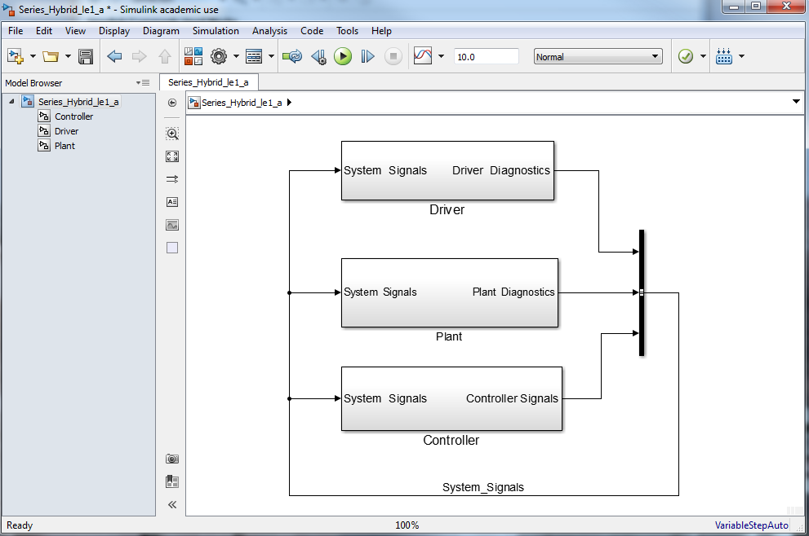
High Level
Notes:
Needs update

Slide 53
High Level
Congratulations! You have
Created a high level hierarchical system
Established communication between the three key subsystems
Gained experience with Simulink
Notes:
Needs update

Slide 54
MBSD Lecture 2
Simple Vehicle Model

Slide 55
Lecture Goals
Create the Vehicle subsystem
Create the MGA subsystem with a preposterous motor model
Observe and assess the results
Notes:
Needs update

Slide 56
Simple Vehicle
Save your previous model (Series_Hybrid_le1_a.slx) as Series_Hybrid_le2_a
In the Model Browser window, click on the Plant subsystem
Move the buses to the bottom of the window
Notes:
Needs update

Slide 57
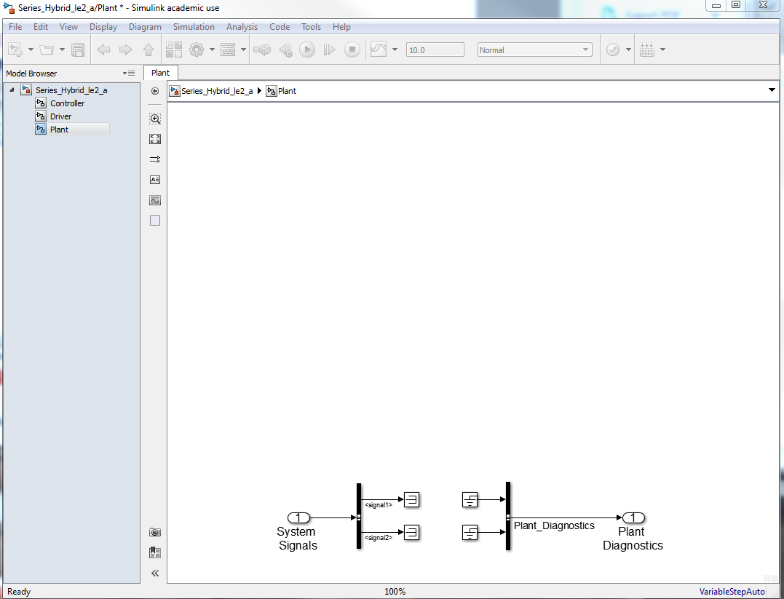
Simple Vehicle
Notes:
Needs update

Slide 58
Simple Vehicle
Drag two Subsystems into the Plant window
Rename them
Vehicle
MGA
Right click on the Vehicle subsystem
Select Rotate & Flip
Flip Block Name
Repeat for the MGA subsystem
Notes:
Needs update

Slide 59
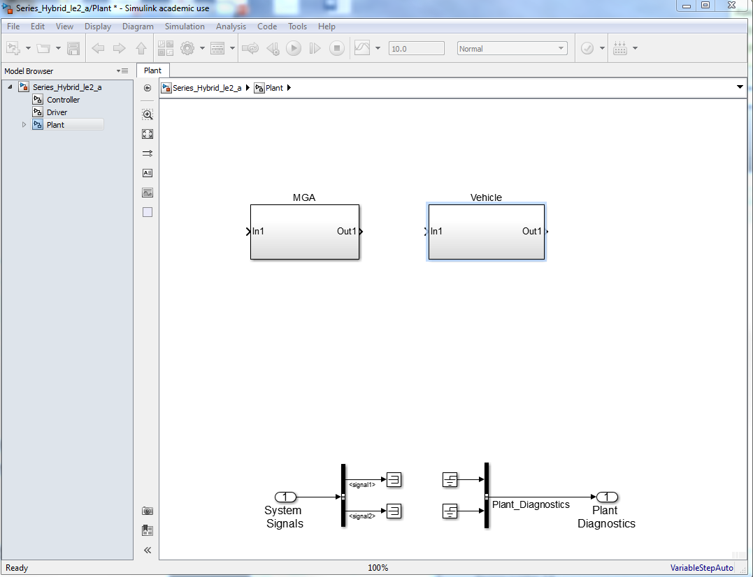
Simple Vehicle
Notes:
Needs update

Slide 60
Simple Vehicle
Let’s also color code our subsystems to make things easy to identify
Right click on the subsystem
Format/Background Color
Make the vehicle gray and MGA red
Notes:
Needs update

Slide 61
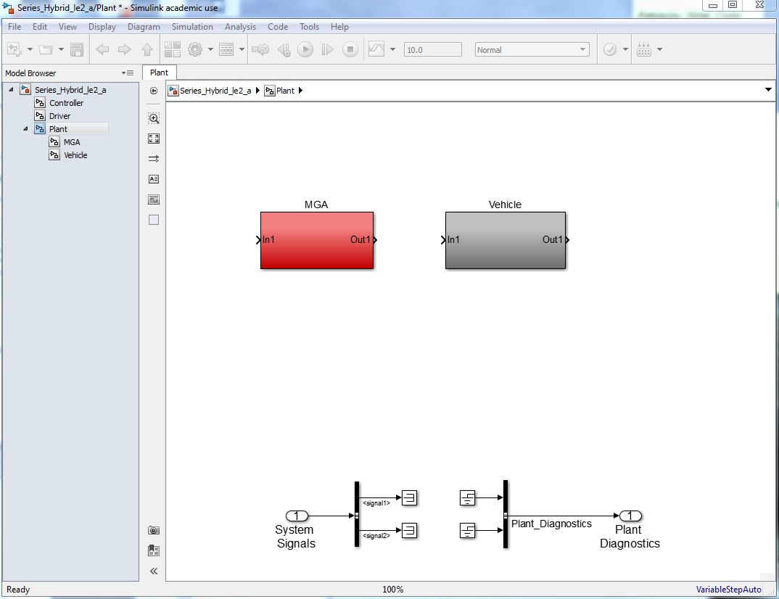
Simple Vehicle
Click to show hierarchical subsystems
Notes:
Needs update

Slide 62
Vehicle Subsystem
The Vehicle subsystem will mechanically receive torque via a shaft from MGA
We will skip mechanical brakes and use exclusively regenerative braking as applied by MGA
The Vehicle subsystem will contain
Posi-trac rear axle
Rear tires
Vehicle solver
Inertias for the driveshaft and axle half shafts
Notes:
Needs update

Slide 63
Vehicle Subsystem
Delete the In1 and Out1 blocks as well as the connecting wire
Copy the In1, Out1, Bus, Terminator, and Ground blocks from the Plant subsystem
Rename Plant to Vehicle
From
Simscape / Utilities
Drag in a Connection Port and rename it Vehicle Mechanical Port
Notes:
Needs update

Slide 64
Vehicle Subsystem
From
Simscape / Driveline / Tires & Vehicles
Drag in the Vehicle Body and one Tire(Magic Formula) blocks
From
Simscape / Driveline / Gears
Drag in a Simple Gear block
Notes:
Needs update

Slide 65
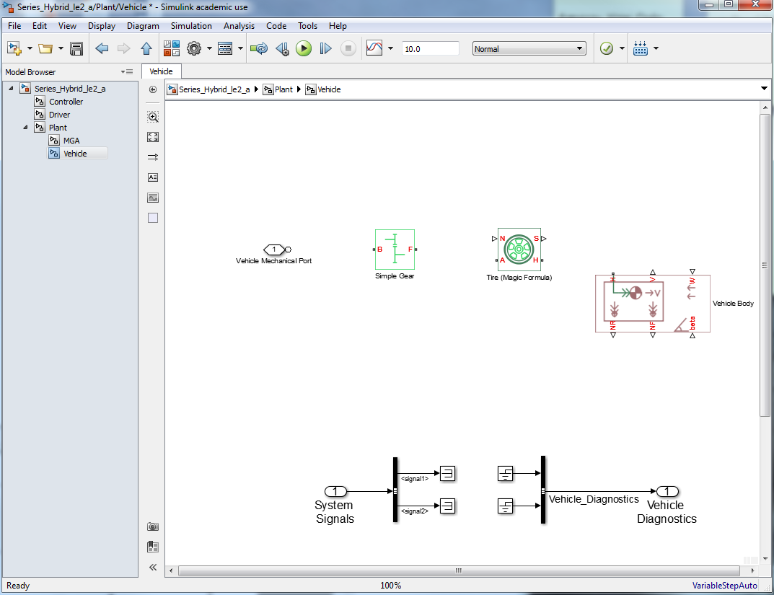
Vehicle Subsystem
Notes:
Needs update

Slide 66
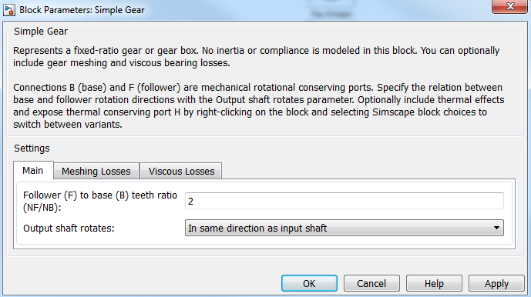
Vehicle Subsystem
Double click on the Simple Gear
We can specify the gear ratio and relative rotational directions
Change the output shaft rotation to the same direction as input shaft
Leave the ratio as 2
Notes:
Needs update

Slide 67
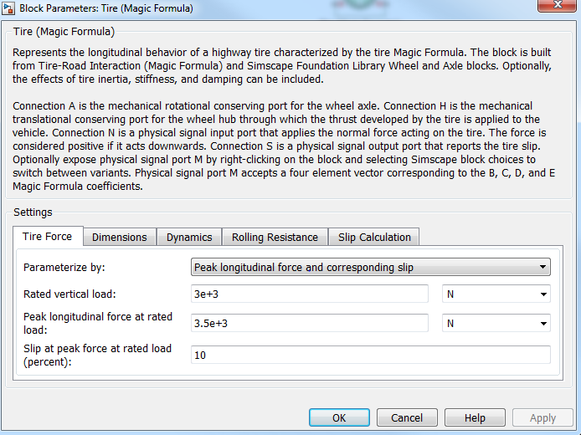
Vehicle Subsystem
Double click on the Tire block
This block converts the applied torque to force in the x-direction
It also determined whether or not the tire slips
Keep the default values
Notes:
Needs update

Slide 68
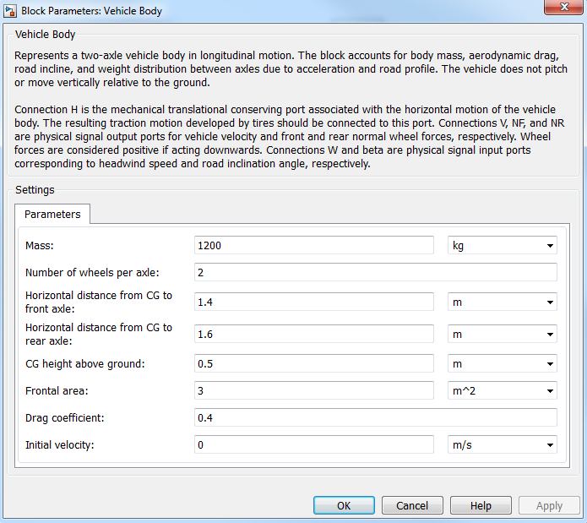
Vehicle Subsystem
Double click on the Vehicle Body block
This block solves linear momentum (with drag and pitch) from the tire force
Keep the default values
Notes:
Needs update

Slide 69
Vehicle Subsystem
Connect the Vehicle Mechanical Port to the Base side of the Simple Gear
Connect the Follower side of the Simple Gear to the A port on the Tire
We now have a model of the driveshaft, rear differential, and axle shaft
Notes:
Needs update

Slide 70
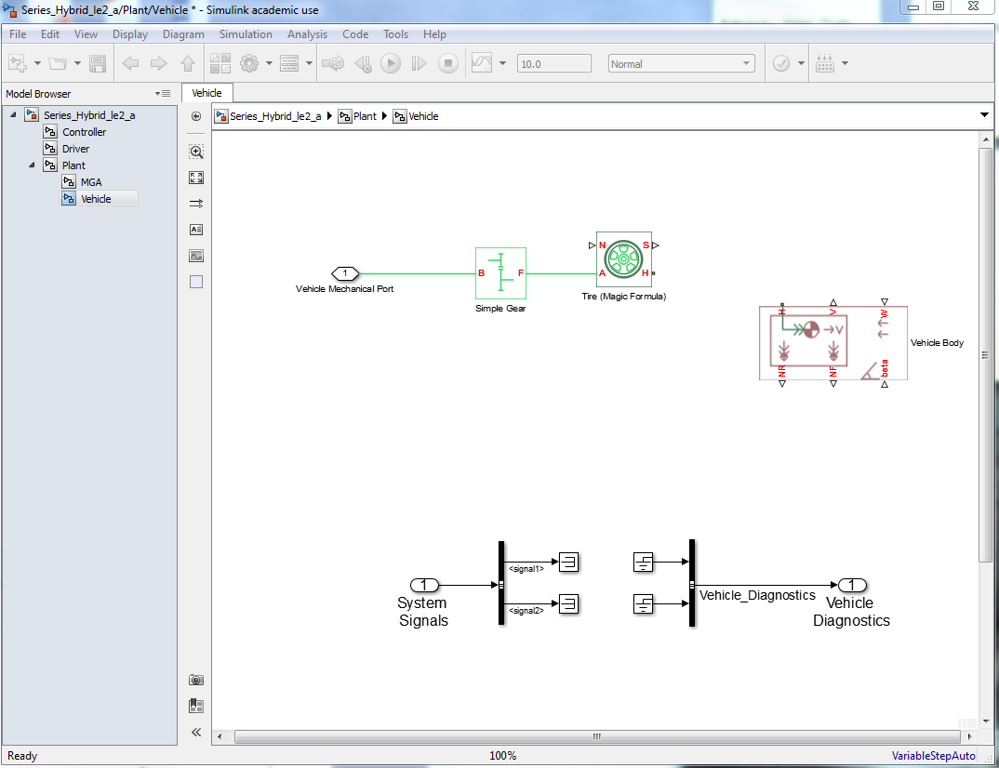
Vehicle Subsystem
Driveshaft
Rear Diff
Rear Axle
Notes:
Needs update

Slide 71
Vehicle Subsystem
Note the difference in between the Driveline connection ports and the Simulink connection ports
They will not connect to each other
Driveline blocks are used to solve the Conservation of Angular Momentum principle during each time step
Notes:
Needs update

Slide 72
Vehicle Subsystem
Every shaft must have a mass moment of inertia
Also, a special solver must be used
From
Simscape / Foundation Library / Mechanical / Rotational Elements
Drag in two Inertia blocks
From
Simscape / Utilities
Drag in a Solver Configuration block
Notes:
Needs update

Slide 73
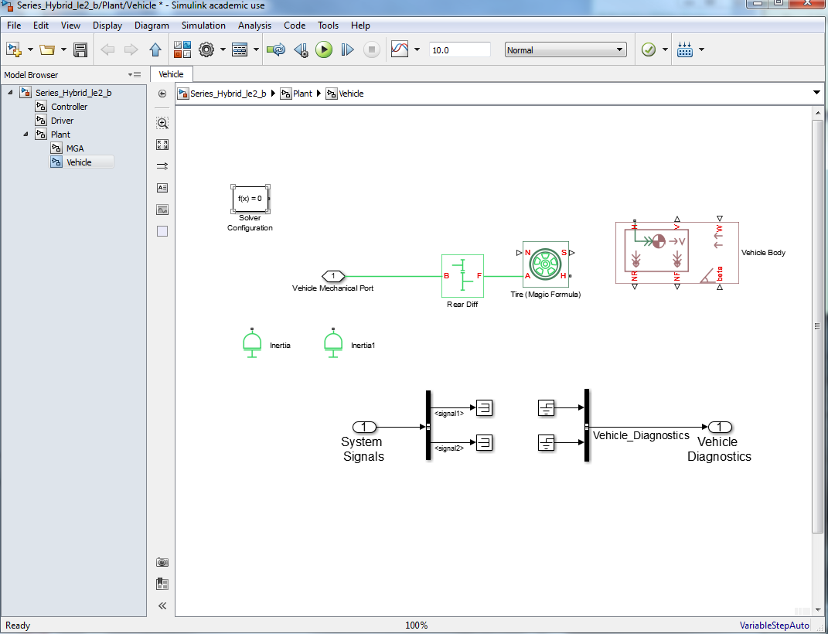
Vehicle Subsystem
Notes:
Needs update

Slide 74
Vehicle Subsystem
Connect the Inertias to the driveshaft and rear axle and Rename them:
Driveshaft Inertia (kg m^2)
Driver Halfshaft Inertia (kg m^2)
Connect the Solver Configuration to the driveshaft
Hide its name
Rename the Tire to Driver Tire
Rename the Simple Gear to Rear Diff
Notes:
Needs update

Slide 75
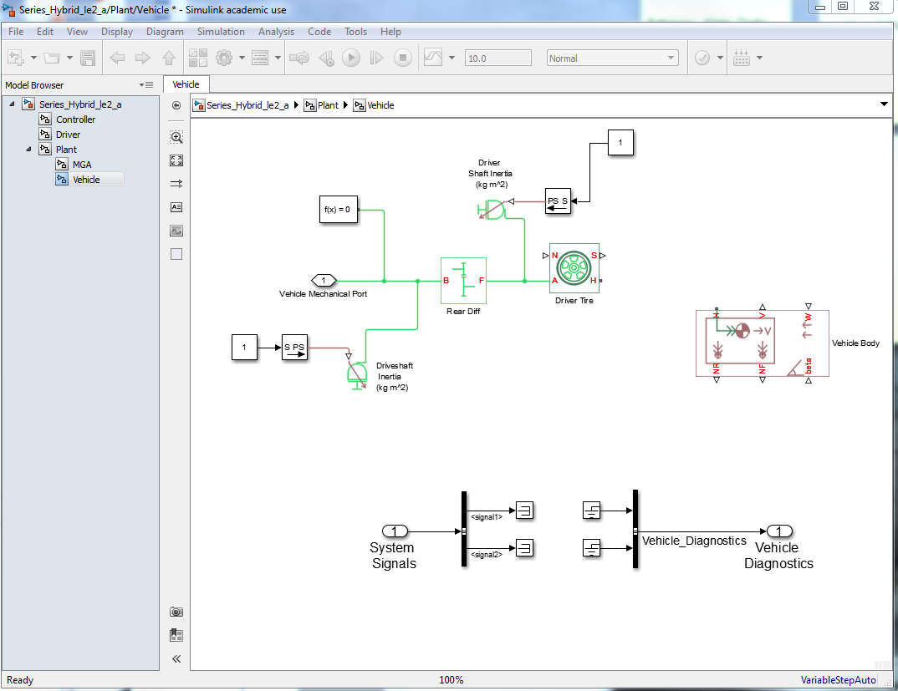
Vehicle Subsystem
Notes:
Needs update

Slide 76
Vehicle Subsystem
Rename and save you your model as Series_Hybrid_le2_b
Now we can connect the H port of the Drive Tire block to the H port of the Vehicle Body block
From
Simscape / Utilities
Drag in two Simulink-PS Converter blocks
These blocks transfer Simulink signals to physical signals
Drag in two Ground blocks
Hide their names
Connect the Ground blocks to the Simulink-PS Converters
Connect the Simulink-PS Converters to the beta and W ports of the Vehicle Body block
Notes:
Needs update

Slide 77
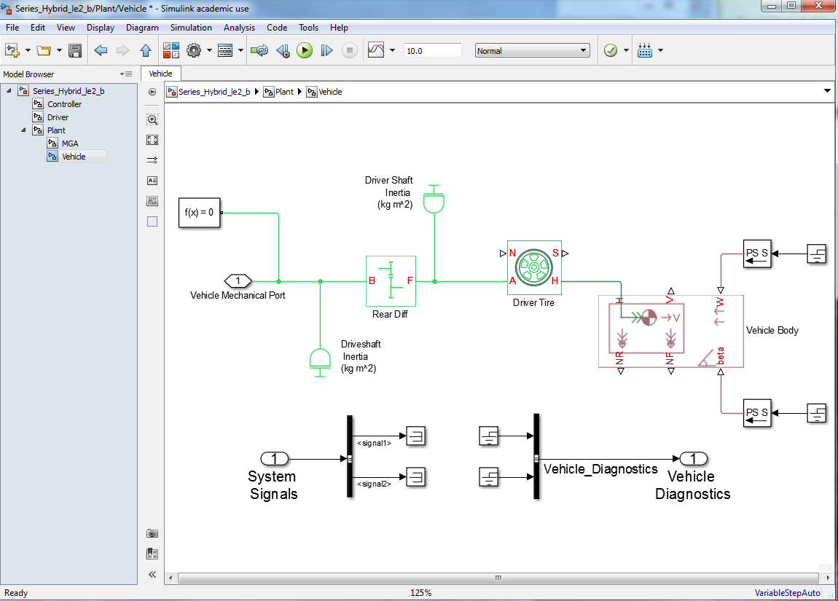
Vehicle Subsystem
Notes:
Needs update

Slide 78
Vehicle Subsystem
The NR port of the Vehicle Body block is a physical signal reporting the normal force applied on the rear wheels
Connect the NR port of the Vehicle Body block to the N port of the Driver Tire block
Rearrange the block and wire to make model look good
S port of the Drive Tire block is a physical signal reporting tire slip
Notes:
Needs update

Slide 79
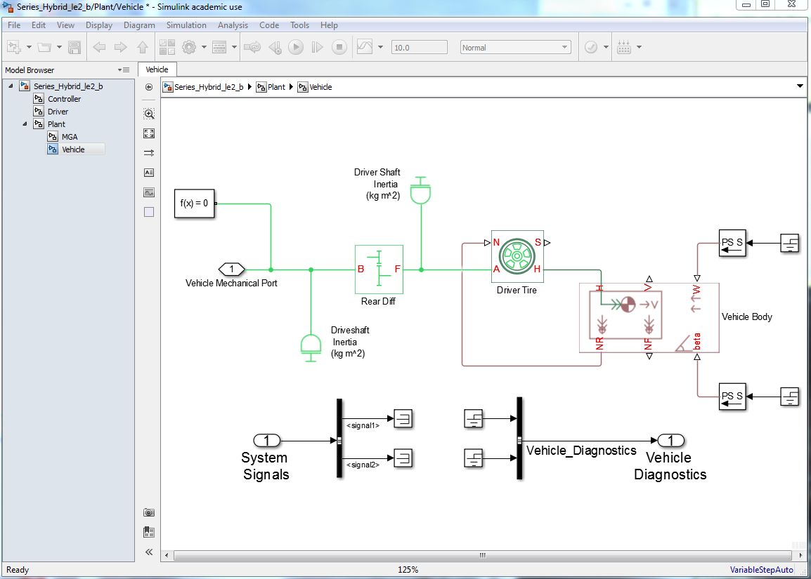
Vehicle Subsystem
Notes:
Needs update

Slide 80
Vehicle Subsystem
S port of the Drive Tire block is a physical signal reporting tire slip
NF port of the Vehicle Body block reports the normal load on the front tires
We are not interested in tire slip or the normal force on the front tire (this is a rear wheel vehicle)
From
Simscape / Utilities
Grab two PS-Simulink Converter blocks (opposite of Simulink-PS Converter)
Grab two Terminator blocks
Hide name of PS-Simulink Converter and Terminator both blocks
Connect the PS-Simulink Converter blocks to the Terminators
Connect the S port of the Drive Tire block and NF port of the Vehicle Body block to the PS-Simulink Converter blocks
Rearrange the block to make the model look good and compact
Notes:
Needs update

Slide 81
Vehicle Subsystem
It is preferred for the wires not to cross as much as possible. You should place your blocks in position to avoid the wire crossing as much as possible
Notes:
Needs update

Slide 82
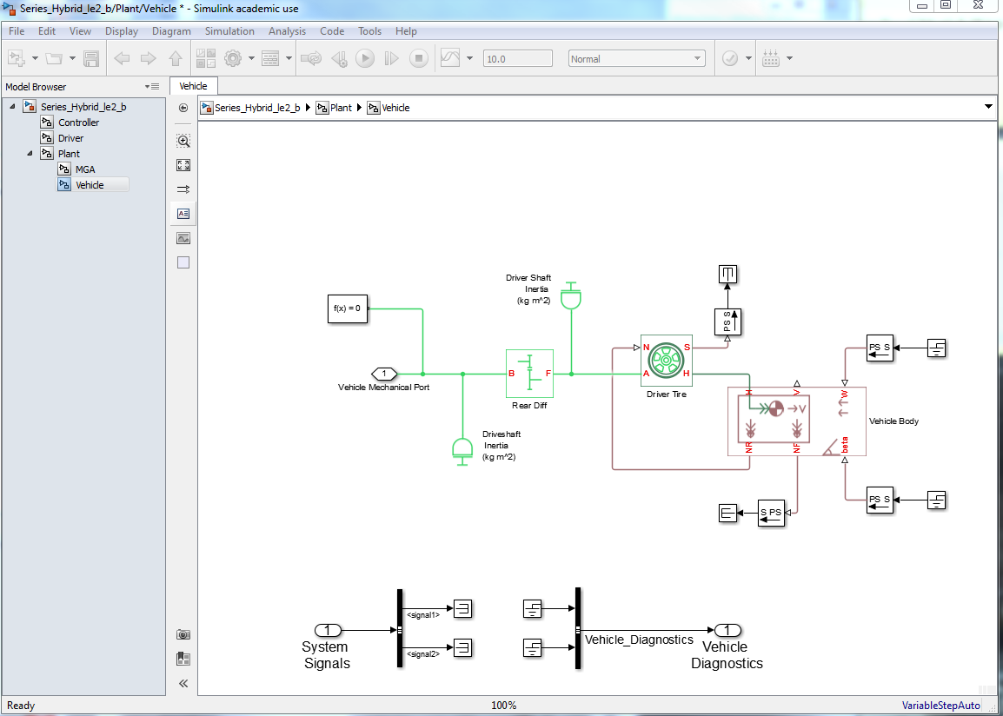
Vehicle Subsystem
Notes:
Needs update

Slide 83
Vehicle Subsystem
We need to send the vehicle velocity signal (from the V port of the Vehicle Body block) to other parts of the model
Grab a PS-Simulink Converter block and connect the V port of the Vehicle Body block to the PS-Simulink Converter
From
Simulink / Signal Routing
Grab a Goto block
Connect the PS-Simulink Converter to the Goto block
Notes:
Needs update

Slide 84
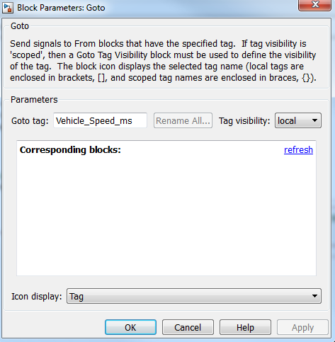
Vehicle Subsystem
Double click on the Goto block and change the tag to Vehicle_Speed_ms
Make sure the visibility is set to local
Click OK
Drag the sides of the Goto block to make the name visible
Hide the name of Goto and PS-Simulink Converter blocks
Notes:
Needs update

Slide 85
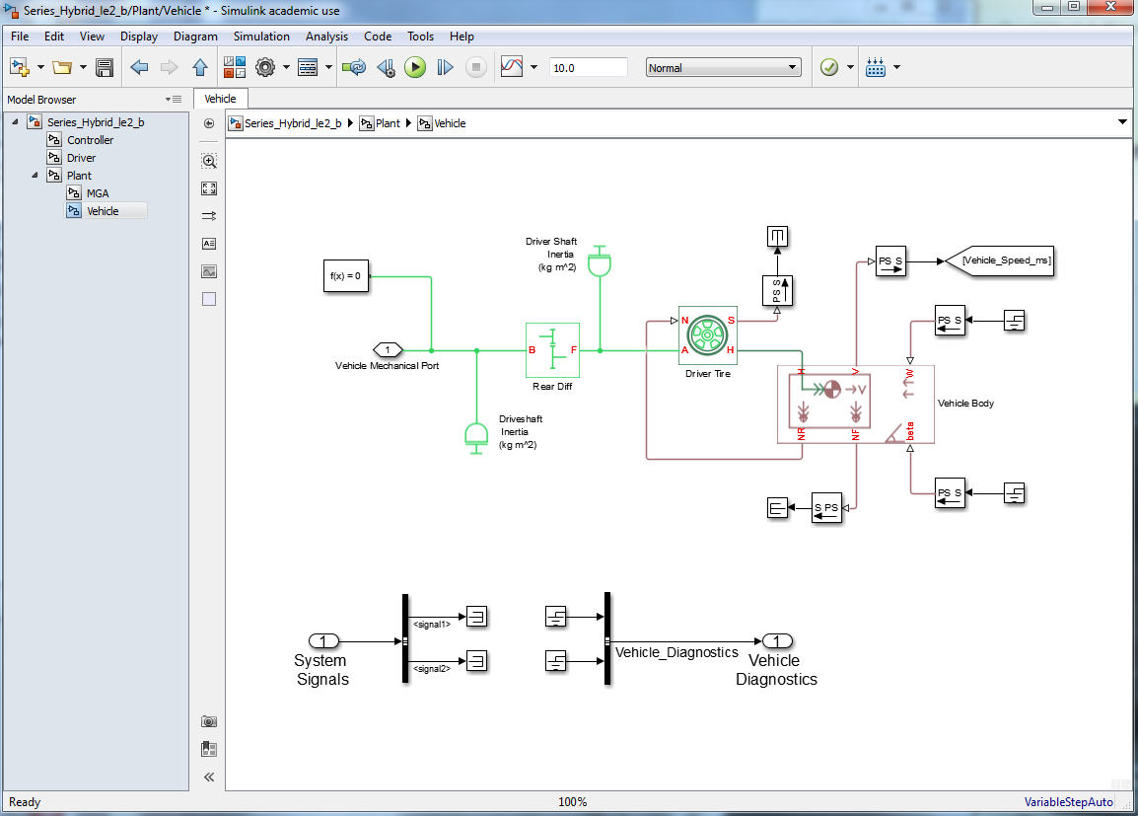
Vehicle Subsystem
Notes:
Needs update

Slide 86
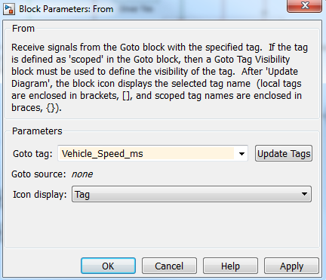
Vehicle Subsystem
From
Simulink / Signal Routing
Grab a From block
Double click on the From block
Open the Goto tag bar and select Vehicle_Speed_ms
Note: if you don’t see Vehicle_Speed_ms, click on Update Tags and try again
Click OK
Hide the name of the From block
Notes:
Needs update

Slide 87
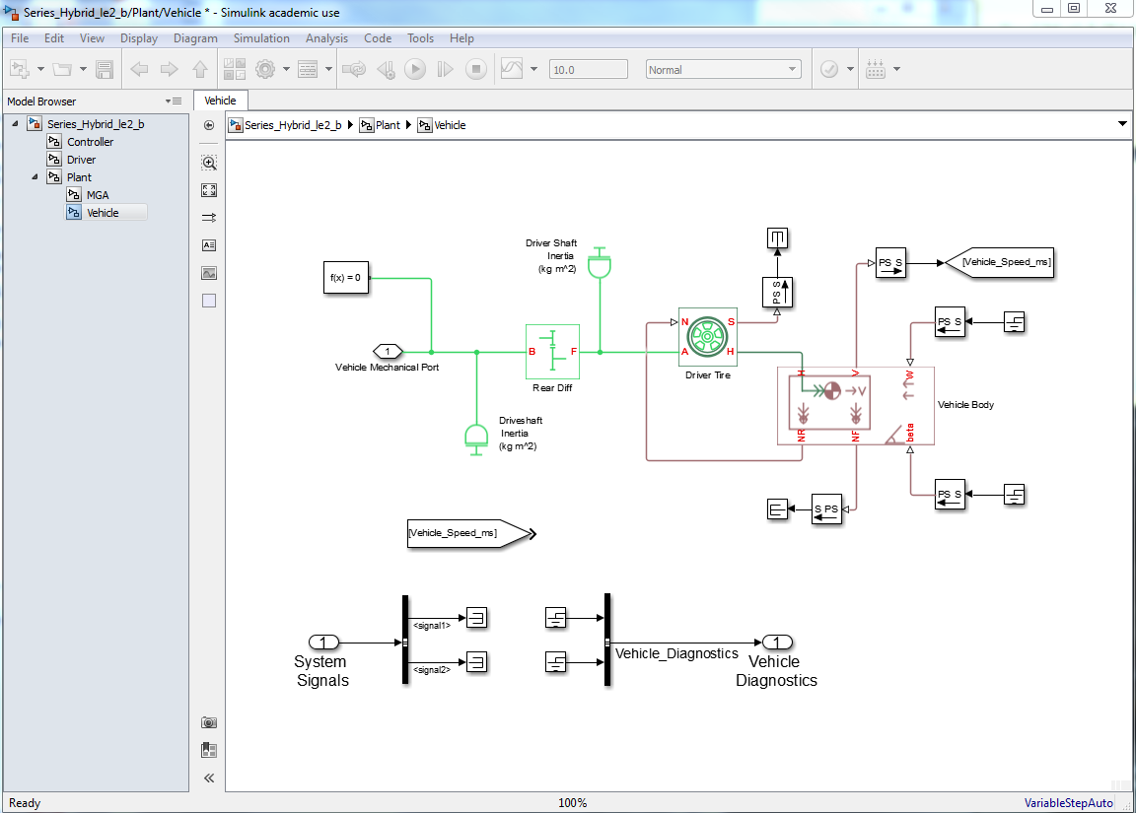
Vehicle Subsystem
Goto
From
Notes:
Needs update

Slide 88
Vehicle Subsystem
Congratulations – you have a model of a vehicle that will (hopefully) move when subjected to a torque
From a vehicle diagnostics perspective, we are interested in two things
Speed (mph)
Distance Traveled (miles)
Move the Vehicle_Speed_ms From block down near the Vehicle Diagnostics Bus
From
Simulink / Commonly Used Blocks
Drag in two Gain blocks and one Integrator block
Hide the name of the Integrator block
Notes:
Needs update

Slide 89
Vehicle Subsystem
Congratulations – you have a model of a vehicle that will (hopefully) move when subjected to a torque
From a vehicle diagnostics perspective, we are interested in two things
Speed (mph)
Distance Traveled (miles)
Move the Vehicle_Speed_ms From block down near the Vehicle Diagnostics Bus
From
Simulink / Commonly Used Blocks
Drag in two Gain blocks and one Integrator block
Hide the name of the Integrator block
Notes:
Needs update

Slide 90
Vehicle Subsystem
Set the first Gain to 2.2374 (m/s to mph)
Set the second Gain to 6.214 e-4 (m/s to miles/s)
Name them accordingly
Connect the output of the From block to the input of the Gain blocks
Connect the second Gain block to the Integrator block
Delete the Grounds going into the Bus
Connect the two signals
Name them: (Double click on the wires)
Vehicle_Speed_mph
Vehicle_Distance_miles
Notes:
Needs update

Slide 91
Vehicle Subsystem
The Vehicle subsystem is done
Note that we did not use any of the system signals
When we get around to mechanical brakes we will need a brake signal
Take some time to move things around and make it look nice
Notes:
Needs update

Slide 92
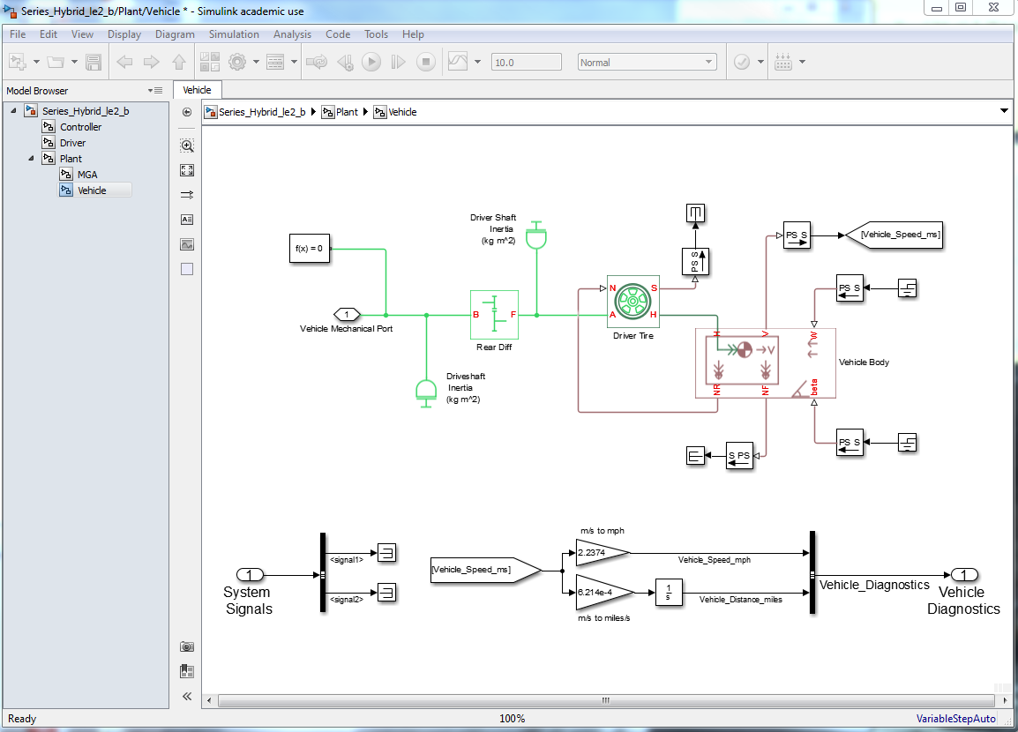
Vehicle Subsystem
Notes:
Needs update

Slide 93
MGA Subsystem
Our motor model is going to be preposterously simple
Constant torque output
No RPM limits
No input power required
Rename and save you model as:
Series_Hybrid_le2_c
Use the Model Browser to go to the MGA subsystem
Notes:
Needs update

Slide 94
MGA Subsystem
Delete the In1, Out1, and the connecting wire
Copy the Bus from the Plant subsystem
Rename accordingly
Drag in a Constant block and rename it MGA Max Torque (Nm)
Set the constant value at 200 Nm
From
Simscape / Foundation Library / Mechanical / Mechanical Sources
Drag in an Ideal Torque Source block and hide its name
Drag in a Connection Port and rename it MGA Mechanical Port
Drag in a Simulink-PS Converter and hide its name
From
Simscape / Foundation Library / Mechanical / Rotational Elements
Grab a Mechanical Rotational Reference block and hide its name
Wire everything together as shown in the next page
Notes:
Needs update

Slide 95
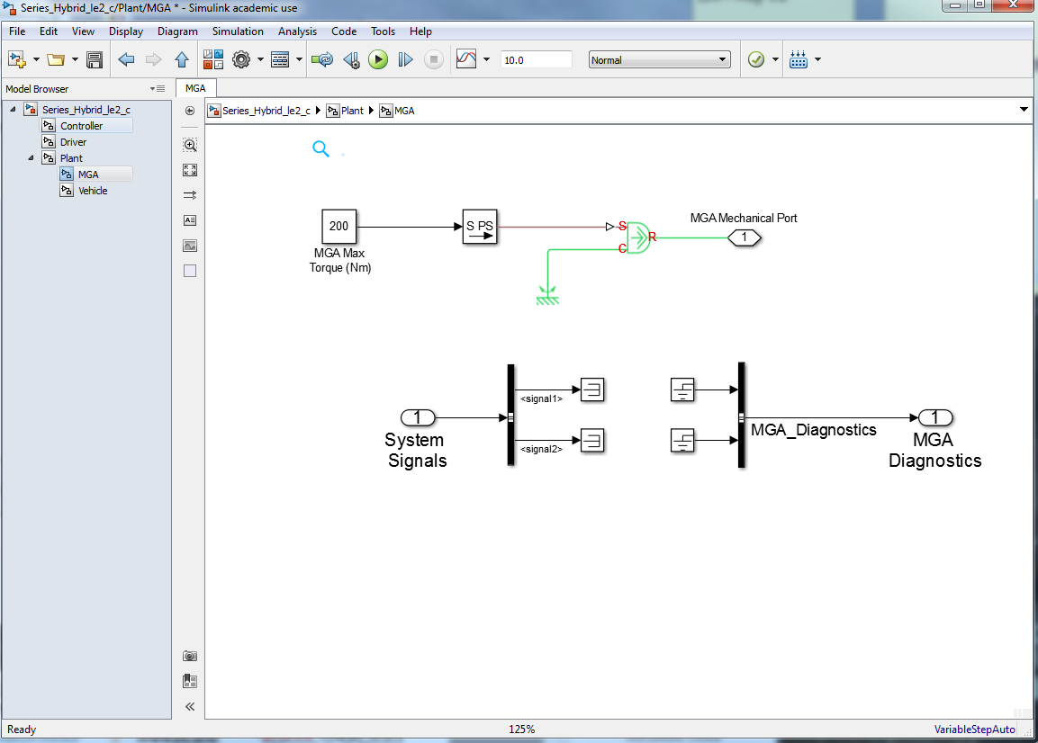
MGA Subsystem
Notes:
Needs update

Slide 96
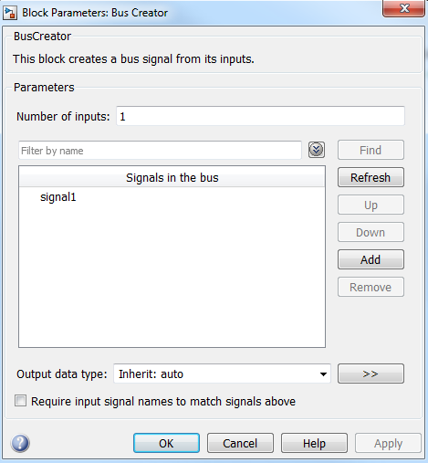
MGA Subsystem
The only MGA diagnostic is the torque
Delete the Terminators
Double click on the Bus Creator and change the Number of inputs to 1
Click OK
Notes:
Needs update

Slide 97
MGA Subsystem
Drag in a pair of Goto and From blocks
Name them accordingly
Use them to route the MGA torque signal to the Bus Creator block
Name the signal going into the Bus
Compare with next slides
Notes:
Needs update

Slide 98

MGA Subsystem
Notes:
Needs update

Slide 99
MGA Subsystem
Congratulations – you’ve made a motor model
It is now time to connect MGA to the Vehicle and see what happens
Save your model as
Series_Hybrid_le2_d
Use the Model Browser to go to the Plant level of the model
Make the MGA and Vehicle subsystems larger
Notes:
Needs update

Slide 100

Plant Level
Notes:
Needs update

Slide 101

Plant Level
The MGA Mechanical Port is on the wrong side of the block
Go into the MGA subsystem and double click on the Port
Change the location from left to right
Click OK
Notes:
Needs update

Slide 102
Plant Level
Connect the two Mechanical Ports
Route the Vehicle and MGA Diagnostics to the Plant Signal CAN Bus
Name the signal inputs accordingly
Change the foreground of the Vehicle routing blocks to gray
Change the foreground of the MGA routing blocks to red
Notes:
Needs update

Slide 103

Plant Level
Notes:
Needs update

Slide 104
Plant Level
All that is left is to route the System Signals to the Vehicle and MGA
Delete the Terminators and the Bus Selector
Use the Goto and From blocks to route the System Signals to MGA and the Vehicle
Notes:
Needs update

Slide 105

Plant Level
Notes:
Needs update

Slide 106
Running the Model
It is now time to run the model
Go to the Vehicle subsystem
From
Simulink / Sinks
Drag in a Scope
Connect it to the Vehicle_Speed_mph signal
Click on the Run button to start the simulation
Notes:
Needs update

Slide 107

Running the Model
Run
Notes:
Needs update

Slide 108

Running the Model
Oh! There is an error
Notes:
Needs update

Slide 109

Running the Model
Since we do not yet need any signals from the System Diagnostics bus, replace the Bus Selector with a Terminator in the
Driver
Controller
Plant / Vehicle
Plant / MGA
subsystems
Notes:
Needs update

Slide 110


Running the Model
Rerun the model
If the scope is not open, double click on the block
Observe the results
0 to 25 mph in 10 seconds
You can check the results by hand
$m\frac{{dv}_{x}}{dt}=\sum{F_{x }}$
$\frac{{dv}_{x}}{dt}=\frac{1}{m}\left(\frac{TN}{r}\right)$
$\int_{v_{i}}^{v_{f}}{{dv}_{x}=\int_{t_{i}}^{t_{f}}{\left(\frac{TN}{mr}\right)dt}}$
$v_{f}=\frac{\left(200 Nm\right)\left(2\right)}{\left(1200 kg\right)\left(0.3 m\right)}=11.1 m/s=24.9 mph$
Gear ratio
Tire radius
Notes:
Needs update

Slide 111
Simple Vehicle
Review
Vehicle subsystem
Receives torque from MGA
Solves vehicle velocity
Sends/Receives CAN messages
MGA subsystem
Provides torque to Vehicle
Sends/Receives CAN messages
Notes:
Needs update

Slide 112
MBSD Lecture 3
Initialization, Solver, Logging & Visualization, and Driver

Slide 113
Lecture Goals
Create an initialization file for data management
Select the correct ODE solver
Create a Data Logging and Visualization subsystem
Create a Driver subsystem
Have the vehicle follow a drive cycle
Experiment with feedback gain
Notes:
Needs update

Slide 114
Initialization File
Save your previous model as
Series_Hybrid_le3_a
Go to the System Level of the model
Right click on any vacant white space on the model
Select Model Properties
Select the Callbacks tab
Click on the InitFcn
Type Vehicle_Init_File_L3 in the second column
Notes:
Needs update

Slide 115

Initialization File
Notes:
Needs update

Slide 116
Initialization File
This is going to be a Matlab M-file which will automatically execute each time the model is run
All of our component parameters will go in this file
Start by going to the Matlab window
Open file
Vehicle_Init_File_L3.m
Notes:
Needs update

Slide 117

Initialization File
Notes:
Needs update

Slide 118
Initialization File
We will replace the numeric values in the blocks with these variable names
This consolidates all key parameters into one location
Help prevent making mistakes
Tip: copy the variable names from the M-file and paste into the block to prevent spelling errors
Update all relevant blocks
Notes:
Needs update

Slide 119

Initialization File
Notes:
Needs update

Slide 120
ODE Solver
While the Solver Configuration calls the hooks for solving the driveline angular momentum, an overall ODE solver must be specified
Our model contains a set of stiff ODEs and as recommended by The MathWorks, best solver suited for this type of ODEs is ODE23t
Notes:
Needs update

Slide 121
ODE Solver
As with the Init file, right click on the model background
Select
Model Configuration Parameters
Solver: ode23t (mod. stiff/Trapezoidal)
Click OK
Run the model and note how much faster it runs!
Notes:
Needs update

Slide 122

ODE Solver
Notes:
Needs update

Slide 123
Logging & Visualization
Let’s now create a subsystem to represent the on-board data logger
This will also be a good place for having all the visualization
First, go to the Vehicle subsystem and delete the Scope block
Having scopes in the model is bad for auto-code generation
Notes:
Needs update

Slide 124
Logging & Visualization
Drag a new Subsystem into the Plant level of the model
Rename it Logging & Visualization
Rename the In1 block to System Signals
Delete the Out1 block
The logger does not send any diagnostics
Drag a Bus Selector into the subsystem
Go back into the Plant level of the model
Copy a System Signals From block and connect it to System Signals of Logging & Visualization subsystem
Notes:
Needs update

Slide 125

Logging & Visualization
Notes:
Needs update

Slide 126

Logging & Visualization
Notes:
Needs update

Slide 127
Logging & Visualization
In the Logging & Visualization subsystem
Double click on the Bus Selector block
In the Selected signals column
Click on signal1 and then Remove
Click on signal1 and then Remove
In the Signals in the bus column
Click on Driver_Diagnostics and then Select
Click on Plant_Diagnostics and then Select
Click on Controller_Diagnostics and then select
Click OK
Notes:
Needs update

Slide 128

Logging & Visualization
Notes:
Needs update

Slide 129
Logging & Visualization
Drag in three Goto blocks and name them Driver_Diagnostics, Plant_Diagnostics, and Controller_Signals
Wire them to the Bus Selector
Drag in three From blocks
Terminate the Driver_Diagnostics and the Controller_Signals From blocks
Drag in a Bus Selector and wire it to the Plant_Diagnostics From block
Notes:
Needs update

Slide 130
Logging & Visualization
Double click on the Bus Selector
Remove signal1 and signal2
Select the Vehicle_Diagnostics and the MGA_Diagnostics signals
Drag in two more Goto blocks
Connect them to the Bus Selector
Name them accordingly
Color them accordingly
Notes:
Needs update

Slide 131

Logging & Visualization
Notes:
Needs update

Slide 132
Logging & Visualization
Drag in two more From and Bus Selector blocks
Select
Vehicle_Diagnostics - first From block
MGA_Diagnostics – second From block
Connect the From blocks to the Bus Selector blocks
Use the Bus Selector blocks to select all signals
Notes:
Needs update

Slide 133

Logging & Visualization
Two Signals
One Signal
Notes:
Needs update

Slide 134
Logging & Visualization
From
Simulink / Sinks
Drag in a To Workspace block
This will write the desired signal values to an array for review when the simulation is done
Double click on the To Workspace block
Make the following changes
Variable name - Vehicle_Speed_mph
Sample time - Logging_Sample_Time_s
Save format – Array
Update the input file
Notes:
Needs update

Slide 135

Logging & Visualization
Very important: Don’t forget this
Notes:
Needs update

Slide 136
Logging & Visualization
Connect the To Workspace block to the Bus Selector
Repeat for the remaining signals coming from the Plant
Color everything accordingly
Notes:
Needs update

Slide 137

Logging & Visualization
Notes:
Needs update

Slide 138
Logging & Visualization
Rather than using Scope blocks, we will use the Signal and Scope Manager to view the signals
Right click on the Vehicle_Speed_mph signal and select
Create & Connect Viewer / Simulink / Scope
Notes:
Needs update

Slide 139

Logging & Visualization
Notes:
Needs update

Slide 140

Logging & Visualization
Note the scope figure on the Vehicle_Speed_mph signal – that denotes that the signal is being scoped
Scope figure
Notes:
Needs update

Slide 141
Driver Subsystem
The Driver subsystem will be our first proportional feedback loop
The vehicle will be at a certain speed
The driver will want to go a different speed
The driver will send a torque request (-1 to 1) to the controller
The vehicle will change speed
Repeat for the duration of the drive cycle
Notes:
Needs update

Slide 142
Driver Subsystem
Save the model as Series_Hybrid_le3_b
Use the Model Browser to go into the established Driver subsystem
Drag in a Bus Selector, a Goto, and a From block
Delete the Terminator and connect the Bus Selector block
Select the Vehicle_Speed_mph signal
Connect this signal to the Goto block
Notes:
Needs update

Slide 143

Driver Subsystem
Notes:
Needs update

Slide 144
Driver Subsystem
The drive cycle will be read in from the workspace
It will contain time (s) and desired speed (mph) at that time
We will use the standard FU505 drive cycle
505 seconds long
Collected data
The data is stored as a .mat file
The .mat file will be loaded with the init file
Notes:
Needs update

Slide 145
Driver Subsystem
From
Simulink / Sources
Drag in a From Workspace block
Double click on it
Rename the Data to: Sch_Cycle
Click OK
Notes:
Needs update

Slide 146

Driver Subsystem
Notes:
Needs update

Slide 147
Driver Subsystem
From
Simulink / Commonly Used Blocks
Drag in a Sum, Gain, and Saturation block
Make the Sum block rectangular with a +-
Drag in another two Goto and From blocks
Arrange, wire, and name as shown on the next slide
Notes:
Needs update

Slide 148

Driver Subsystem
Driver_Speed_Desired_mph
Driver_Torque_Request
Notes:
Needs update

Slide 149
Driver Subsystem
We must now determine the value of the error amplifier
Classical controls theory would have us generate a transfer function and look for poles
This system will soon become so complex that classic approaches do not work
Instead use some experience
If you are driving a car and want to go
1 mph faster
10 mph faster
20 mph faster
You step on the gas (torque request)
Very little
Half way
To the floor
Notes:
Needs update

Slide 150

Driver Subsystem
The torque request will vary from
+1
full positive torque requested
20 mph+ too slow
-1
Full negative torque requested
20 mph+ too fast
A gain of 0.05 will send a $±$1 at 20 mph error
A Saturation will limit the request to $±$1
Notes:
Needs update

Slide 151

Driver Subsystem
Notes:
Needs update

Slide 152

Driver Subsystem
The final step in the Driver subsystem is to add the desired drive cycle to the initialization file
Notes:
Needs update

Slide 153
Driver Subsystem
Run the init file manually to load the drive cycle
At the Matlab command line type
plot(Sch_Cycle(:,1),Sch_Cycle(:,2))
Notes:
Needs update

Slide 154
Controller Subsystem
The Driver torque request will next be sent through the CAN bus to the Controller subsystem
Go to the Controller subsystem, delete the Terminators and Grounds, and drag in a Gain, a Bus Selector, two Goto, and two From blocks
On the Bus Selector, select the Driver_Torque_Request signal
Wire and label as shown on the next slide
Notes:
Needs update

Slide 155

Controller Subsystem
mga_torque_request
Notes:
Needs update

Slide 156
Controller Subsystem
The driver torque request passes through the controller where it is sent to MGA
Just like a real vehicle
The Gain block can be modified
Sporty : increase request
Economy : decrease request
Naming convention
All Control signals will be lowercase
End with either “request” or “enable”
Notes:
Needs update

Slide 157
MGA Subsystem
The last step is to pass the torque request to MGA
Drag in a Bus Selector, a Goto, a From, and a Product block
Delete the Terminator
Select the mga_torque_request signal
Wire and label as shown on the next slide
Notes:
Needs update

Slide 158

MGA Subsystem
Notes:
Needs update

Slide 159
Run the simulation
Go to the model level and Run the model
Notes:
Needs update

Slide 160

Results
Run the model and observe the scope
It only ran for 10 seconds
Notes:
Needs update

Slide 161

Results
Open the Configuration Parameters
Change the Stop Time to
Sch_Cycle(end,1)
Notes:
Needs update

Slide 162

Results
Run the simulation again
Awesome! The vehicle is doing something!
Note: in the Scope, go to Tools / Axes Scaling
Select: Automatically Scale Axis Limits
But How well?
Notes:
Needs update

Slide 163
Logging & Visualization
Go to the Logging & Visualization subsystem
Delete the Terminator on the Driver_Diagnostics From block
Use a Bus Selector to extract all Driver signals
Drag in two To Workspace blocks to log the Driver Data
Repeat for the Controller Signals
Notes:
Needs update

Slide 164

Logging & Visualization
Notes:
Needs update

Slide 165
Logging & Visualization
Right click on the Driver_Speed_Desired_mph signal
Select
Connect to Existing Viewer
Scope
Rerun the simulation and observe the scope
Notes:
Needs update

Slide 166

Logging & Visualization
Notes:
Needs update

Slide 167

Results
Our vehicle does a poor job of following the drive cycle
Increase the MGA max torque in the init file until the traces are similar
Yellow trace
Blue trace
Notes:
Needs update

Slide 168

Results
Even with 1000 Nm, the vehicle still can not follow the trace exactly
Put the torque back to 200 Nm
Notes:
Needs update

Slide 169

Results
Let’s see what the driver is doing
On the scope
Select
View / Layout
Choose a 2×1 layout
Now we can add signals to both Axis 1 and Axis 2
Notes:
Needs update

Slide 170
Results
In the Logging & Visualization subsystem
Right click on the Driver_Torque_Request signal
Select
Connect to Viewer / Scope / Axes 2
This will put the Driver torque request directly below the drive cycle
Rerun the simulation
Notes:
Needs update

Slide 171

Results
Wow – the driver torque request never goes above about 0.7
Why?
Notes:
Needs update

Slide 172
Results
Note that the vehicle is “chasing” a velocity and only occasionally off by more than 10 mph
Change the error amplifier in the Driver subsystem to make the driver more aggressive
Increasing the gain
Decreases the proportional error
Allows the system to respond faster
Can cause overshoot and oscillations
Notes:
Needs update

Slide 173
Results
An error amplifier of 1 should work quite well
Notes:
Needs update

Slide 174

Results
As we expected, error amplifier of 1 worked quite well for this drive cycle
What about for a different drive cycle?
Notes:
Needs update

Slide 175
Results
In the init file
Change the drive cycle to Schedule_Boston_Cab.mat
Increase the MGA torque to 1000 Nm
Rerun the simulation
Notes:
Needs update

Slide 176

Results
Definitely some overshoot
Notes:
Needs update

Slide 177
Results
In the init file
Change the drive cycle back to the FU505
Change the MGA torque back to 200 Nm
In the Driver subsystem
Change the error amplifier to 0.5
Rerun the simulation
Notes:
Needs update

Slide 178

Results
This provides a good balance of trace correlation and driver torque request
Notes:
Needs update

Slide 179
Initialization, Solver, and Driver
Review
Created an initialization file to manage data
Changed to appropriate ODE solver
Created a logging and graphics subsystem
Developed driver proportional feedback loop
Velocity mismatch generates an error signal
Error signal converted to a driver torque request
Driver torque request goes to controller
Controller requests MGA torque
System response very sensitive to feedback gain value
Notes:
Needs update

Slide 180
MBSD Lecture 4
Improved MGA and Simple Battery

Slide 181
Outline
Make MGA an ideal electromechanical device
Create a preposterous battery to power MGA
Track the battery state of charge (SOC)
Notes:
Needs update

Slide 182
MGA
Save your model as Series_Hybrid_le4_a.slx
Go into the MGA subsystem
MGA will still
Have a constant maximum torque
Have no rpm limits
Be modulated by the Controller
By providing torque at a given RPM, power is transferred to the Vehicle
Notes:
Needs update

Slide 183
MGA
From
Simscape / Foundation Library / Mechanical / Mechanical Sensors
Drag in an Ideal Rotational Motion Sensor block
From
Simscape / Foundation Library / Mechanical / Rotational Elements
Drag in a Mechanical Rotational Reference block
Also drag in three Gotos, two Froms, two Gains, two PS-Simulink Converters, One Terminator and a Product block
Arrange and wire as shown on the next slide
Notes:
Needs update

Slide 184

MGA
Notes:
Needs update

Slide 185


MGA
Add the MGA_Speed_rpm and MGA_Mechanical_Power_kW to the MGA diagnostics bus
In the Logging & Visualization subsystem, extract and log these signals
Notes:
Needs update

Slide 186
MGA & Battery
To make the mechanical power, the motor will need to receive electrical power from the battery
This power will be the battery voltage times the current drawn
Let’s now add an ideal battery to the Plant
Drag in a Subsystem and rename it Battery
Make the background orange
Notes:
Needs update

Slide 187
Battery
The Battery will receive the system signals and broadcast its diagnostics
Delete the wire connecting the In1 and Out1 blocks and rename them System Signals and Battery Diagnostics
Terminate the System Signals
Drag in a Bus Creator, connect it to the Battery Diagnostics, and ground the inputs
Notes:
Needs update

Slide 188
Battery
Electrically, the battery will
Tell MGA its voltage
Receive a current demand from MGA
From
Simulink / Commonly Used Blocks
Drag in an In1 and an Out1 block
Rename them
MGA Current Input (A)
Battery Voltage Output (V)
Notes:
Needs update

Slide 189

Battery
Notes:
Needs update

Slide 190
Battery
For now, the battery voltage will be constant and defined in the init file
Drag in a Constant block
Rename it Battery Voltage (V)
Give it a variable name of Battery_Voltage
Connect it to the Battery Voltage Output
Update the init file for the battery voltage to be 336V
Notes:
Needs update

Slide 191

Battery
Notes:
Needs update

Slide 192
Battery
Our magic battery can provide any amount of current required by the motor
Put the battery current and the battery voltage on the Battery Diagnostics bus
Notes:
Needs update

Slide 193

Battery
Notes:
Needs update

Slide 194
Battery
Outstanding, we now have a constant voltage power source with unlimited amperage and capacity
Return to the Plant level of the model
Make the Battery subsystem larger
Drag in three From and two Goto blocks
Wire and label as shown on the next slide
Convention
Physical signals get colored background
CAN signals get colored foreground
Notes:
Needs update

Slide 195

Battery
Notes:
Needs update

Slide 196

Battery
Place the Battery Diagnostics onto the Plant CAN bus
Extract the Battery signals in the Logging & Visualization subsystem
Notes:
Needs update

Slide 197
MGA
Save the model as Series_Hybrid_le4_b.slx
In the MGA subsystem, drag in an In1 and Out1 block
Rename them
Battery Voltage Input (V)
MGA Current Output (A)
For now, the electrical power from the battery will equal the mechanical power from the motor
Notes:
Needs update

Slide 198
MGA
Thus the current required will be the mechanical power divided by the battery voltage
From
Simulink / Math Operations
Drag in a Divide block
When MGA is drawing current, it will come out of the battery
Drag in a Gain block and give it a value of -1
Notes:
Needs update

Slide 199

MGA
Notes:
Needs update

Slide 200
MGA
Place the MGA Current signal onto the diagnostics bus
Label it MGA_Current_A
Extract the signal in the Logging & Visualization subsystem
Notes:
Needs update

Slide 201

MGA / Logging & Visualization
Notes:
Needs update

Slide 202
MGA
Return to the Plant level of the model
Make the MGA subsystem larger
Use a Goto and a From block to connect MGA to the Battery
Color accordingly
Notes:
Needs update

Slide 203

MGA
Notes:
Needs update

Slide 204
Logging & Visualization
Let’s now observe the MGA current as it follows the FU505 drive cycle
Go to the Logging & Visualization subsystem
Add a third axis to the Scope
Place the MGA_Current_A signal on the third axis
Run the simulation
Notes:
Needs update

Slide 205

Results
Vehicle acceleration
Vehicle deceleration
Positive torque request
Negative torque request
Positive Current
Negative Current
Notes:
Needs update

Slide 206
Battery SOC
Let’s add battery charge to our model
Battery Capacity is in units of Amp hours
The amount of charge transferred by a constant current of one amp for one hour
Thus we can integrate the battery current to find out how much charge has been removed
This value can be non-dimensionalized by dividing by the maximum capacity of the battery to get the State of Charge (SOC)
1 fully charged
0 fully discharged
Notes:
Needs update

Slide 207
Battery SOC
In the Battery subsystem, drag in
An Integrator block
A Gain block
1/3600
Two Constant blocks
Battery_Capacity 8.5 Ahrs
Battery_Initial_SOC 0.7
A Divide block
And a Sum block
Arrange as shown on the next slide
Notes:
Needs update

Slide 208

Battery SOC
Notes:
Needs update

Slide 209
Battery SOC
Add the Battery_SOC signal to the Battery Diagnostics bus
Extract the signal in the Logging & Visualization subsystem
Right click on the Driver_Torque_Request signal
Select Disconnect Viewer
Select Scope
Select Axes 2
Add the SOC signal to Axes 2
Notes:
Needs update

Slide 210

Logging & Visualization
Notes:
Needs update

Slide 211

Initialization
The last step is to add the two new battery parameters to the init file
Run the Simulation
Notes:
Needs update

Slide 212

Results
“Constant” high speed
Vehicle decelerates
Vehicle accelerates
SOC Decreases
Sharp drop in SOC
SOC Increases
Notes:
Needs update

Slide 213
Review
Developed an electromechanical model of MGA
100% efficient
Constant torque capable
No rpm limits
Developed an electrical battery model
100% efficient
Constant voltage capable
No current limits
SOC ready
Notes:
Needs update

Slide 214
MBSD Lecture 5
Simple Charging logic

Slide 215
Outline
Simple Battery charging
Simple GenSet charge logic
Notes:
Needs update

Slide 216
Battery SOC
While having our vehicle follow a drive cycle, the Battery SOC decreased
Eventually, the Battery SOC will get too low
Permanent damage
Stranded motorist
This will require an on-board power generating unit
Diesel engine and MGB
Notes:
Needs update

Slide 217
Battery SOC / GenSet
The net effect of the GenSet is to provide power to the battery
MGB current at Battery voltage
Let’s make a ridiculously simple MGB
Constant current output
Rename the model Series_Hybrid_le5_a.slx
In the plant level of the model, drag in a new Subsystem and rename it MGB
Make the background green
Notes:
Needs update

Slide 218
MGB
In the MGB subsystem
Delete the connecting wire
Create the System Signals and MGB Diagnostics bus
Drag in a Constant block
Rename it MGB Current (A)
Give it a value of 5
Drag in an Out1 block
Rename it MGB Current Output (A)
Put the current on the Diagnostics Bus
Notes:
Needs update

Slide 219

MGB
Notes:
Needs update

Slide 220
MGB
Return to the Plant level and put the MGB Diagnostics on the Plant Diagnostics Bus
Connect a System Signals From block
Go to the Logging & Visualization subsystem and extract the MGB diagnostics
Color accordingly!
Notes:
Needs update

Slide 221

MGB
Notes:
Needs update

Slide 222
MGB / Battery
Return to the Plant level of the model and use a Goto and a From block to make the electrical connection to the Battery
Notes:
Needs update

Slide 223

MGB / Battery
Notes:
Needs update

Slide 224
Battery
Drag in an In1 block and rename it MGB Current Input (A)
Drag in a Sum block and add the two Current Inputs together
Connect the output to the Battery_Current Goto block
Excellent – both MGs can remove/provide current from/to the Battery
Return to the Plant level and connect the MGB_Current_A From block
Notes:
Needs update

Slide 225

Battery
Notes:
Needs update

Slide 226
Battery
In the Logging & Visualization subsystem
Right click on the Battery_SOC signal
Create a new scope
Give it three axis
Axis 1 – Battery SOC
Axis 2 – Battery Current
Axis 3 – MGA and MGB Current
Run the simulation
Notes:
Needs update

Slide 227

Results
Notes:
Needs update

Slide 228
Results
The “trickle charge” of a constant 5 amps kept the SOC up but the Battery was still charge depleting
Vary the value of the MGB current until the Battery is relatively charge sustaining
Notes:
Needs update

Slide 229

Results
0.7 SOC
0.7 SOC
8 Amps
Notes:
Needs update

Slide 230
GenSet Controls
Our series electric vehicle will use a genset which will be activated intermittently
SOC too low : start charging battery
SOC too high : stop charging battery
Let’s make the idealized genset do exactly that via MGB and a state machine
Go to the Controller level of the model
Notes:
Needs update

Slide 231
GenSet Controls
From
Simulink / Stateflow
Drag in a Chart block
Rename it GenSet Controller
Double click on it
The first logical state will be the “no charge” state
The Battery SOC is above the lower limit
Notes:
Needs update

Slide 232

Stateflow
Left click on the State icon
Left click on the window
Name the state
No_Charge
On entry, set the MGB charge enable to 0
Create a charge state
Notes:
Needs update

Slide 233

Stateflow
Notes:
Needs update

Slide 234
Stateflow
To go from one state to another, a transition must occur
These transitions are controlled by parameters called guards
If, at the instance the guard is queried, the parameters are true then the transition occurs
Let’s now create the transitions followed by the guards
Notes:
Needs update

Slide 235

Stateflow
Place the mouse over the No_Charge state
Left Click
Hold and drag to the Charge state
Connect the Charge back to the No_Charge
Notes:
Needs update

Slide 236

Stateflow
Left click on the right transition
Replace the question mark with the code at right
Enclosed in square brackets
Repeat for the second transition
[Battery_SOC<battery_soc_low]
[Battery_SOC>=battery_soc_high]
Notes:
Needs update

Slide 237
Stateflow
Stateflow needs to know which state to “wake up” in
The default transition was created when the first state was placed
Default transition
Notes:
Needs update

Slide 238
Stateflow
We need to add the Battery_SOC input from Simulink into Stateflow
Select
Chart / Add Inputs & Outputs / Data Input From Simulink
Change the Name to Battery_SOC
Click OK
If you select
Tools / Model Explorer
You can see that Battery_SOC has been added
Close Model Explorer
Notes:
Needs update

Slide 239

Stateflow
Notes:
Needs update

Slide 240
Stateflow
Similarly we need to add the value of mgb_charge_enable to Simulink
Select
Chart / Add Inputs & Outputs / Data Output to Simulink
Change the Name to mgb_charge_enable
Click OK
We also need to add the guards as parameters
Select
Chart / Add Other Elements / Parameter…
Change the Name to battery_soc_low
Click OK
Repeat for battery_soc_high
Notes:
Needs update

Slide 241
Stateflow
The final step is to set the frequency at which the guards are queried
Select
Chart / Add Inputs & Outputs / Event Input From Simulink
Change the Name to Clock
Click OK
After this step, Model Explorer should be as shown in the next slide
Notes:
Needs update

Slide 242

Model Explorer
Notes:
Needs update

Slide 243
GenSet Controller
Return to the Controller level of the model
Make the GenSet Controller subsystem larger
Extract the Battery_SOC from the System Signals bus and route it to the GenSet Controller
Route the mga_charge_enable signal to the Control Signals bus and add it
Notes:
Needs update

Slide 244

GenSet Controller
Notes:
Needs update

Slide 245
GenSet Controller
From
Simulink / Sources
Drag in a Sine Wave block
Rename it 10ms
Connect it to the Clock Port
Double Click on it
Change the Frequency to 100*(2*pi)
Click OK
Notes:
Needs update

Slide 246

GenSet Controller
Notes:
Needs update

Slide 247
GenSet Controller
Excellent, we have built a simple two state controller which, based on the Battery SOC, will determine whether or not it should be charged
This check will be performed every 10 ms
In the init file, we need to add guards
Low SOC : 0.6
High SOC : 0.7
Add to the init file
Notes:
Needs update

Slide 248

GenSet Controller
Notes:
Needs update

Slide 249
MGB
Return to the MGB subsystem
Extract the mgb_charge_enable signal from the System Signals
Drag in a Product block and multiply the mgb_charge_enable signal with the MGB Current block
Run the simulation
Notes:
Needs update

Slide 250

MGB
Notes:
Needs update

Slide 251

Results
SOC drops below 0.6
MGB starts charging
Notes:
Needs update

Slide 252
Results
In the init file, change the drive cycle to
Schedule_FU505_Ten_Times.mat
Increase the MGB current to 50 amps
Run the simulation
MGB now cycles on and off
Watch the Stateflow chart
The current state is highlighted during the simulation
Notes:
Needs update

Slide 253

Results: MGB not charging
Notes:
Needs update

Slide 254

Results: MGB charging
Notes:
Needs update

Slide 255
GenSet and Stateflow
Review
Created a simple GenSet which provides current to recharge the battery
Tweaked the trickle charge current for charge sustaining
Created a state controller to turn the charge on and off
Notes:
Needs update

Slide 256
MBSD Lecture 6
Improved GenSet and Controls

Slide 257
Outline
Improved MGB model
Simple diesel engine model
Charging logic
Notes:
Needs update

Slide 258
Improved GenSet
Previously, the GenSet simply provided a constant current
Improvements
Diesel Engine
Constant torque
Speed control
MGB
Recycle MGA model
Rename your model
Series_Hybrid_le6_a.slx
Notes:
Needs update

Slide 259
Improved MGB
Delete the MGB model you just got done making
Copy the MGA model
Make it green
Rename EVERYTHING from MGA to MGB
Add the MGB max torque to the init file
200 Nm
Update the Logging & Visualization for MGB
Note: We will create the signal for mgb_torque_request later in the controller subsystem
Notes:
Needs update

Slide 260

Improved MGB
We will make this signal later in the Controller
Notes:
Needs update

Slide 261

Logging & Visualization
Notes:
Needs update

Slide 262
Engine
Return to the Plant level, drag in a Subsystem, and rename it Engine
Make it yellow
In the Engine subsystem, create the System Signals and Engine Diagnostics bus
Drag in a Connection Port for the mechanical connection to MGB
Notes:
Needs update

Slide 263

Engine
Notes:
Needs update

Slide 264
Engine
Drag in
One Constant
One Simulink-PS Converter
One Ideal Torque Source
One Inertia
One Ideal Rotational Motion Sensor
One Gain
One Terminator
One Product
Two Goto
Two PS-Simulink Converters
Two Mechanical Rotational References
Arrange and label as shown on the next slide
Notes:
Needs update

Slide 265

Engine
Notes:
Needs update

Slide 266
Engine
Our engine torque will be modulated with a throttle request from the Controller
Range of 0 to 1
Analogous to a driver stepping on the accelerator pedal
Place the engine torque and speed on the Diagnostic bus
Notes:
Needs update

Slide 267

Engine
Notes:
Needs update

Slide 268
Engine
Return to the Plant level of the model
Connect a System Signals From block
Place the Engine Diagnostics on the CAN Bus
Connect the Engine mechanical port to the MGB mechanical port
Go to the Logging & Visualization and extract the Engine diagnostics
Notes:
Needs update

Slide 269

Engine
Notes:
Needs update

Slide 270

Logging & Visualization
Notes:
Needs update

Slide 271

Engine
Now place the Engine parameters into the init file
Engine_Max_Torque = 200 Nm
Engine_Inertia = 1.5e-3 kg m^2
Notes:
Needs update

Slide 272
Engine / Controller
To keep things simple
No Charge State
MGB charge enable = 0
Engine throttle request = 0
Charge State
MGB charge enable = 1
Engine throttle request = 0.5
Add the new engine throttle data to the Stateflow Controller
Place the engine throttle signal on the bus
Notes:
Needs update

Slide 273

Controller
Notes:
Needs update

Slide 274

Controller
Notes:
Needs update

Slide 275
Engine / GenSet
Return to the Engine subsystem and extract the throttle request signal
Excellent, the first pass Engine and associated improved GenSet is complete
Drag in a Solver Configuration block and connect the block as shown in the next slide
Notes:
Needs update

Slide 276

Engine
Notes:
Needs update

Slide 277
Controller
The controller will need to send a torque request to MGB to hold the engine at a constant desired speed
Engine too fast – increase torque
Engine too slow – decrease torque
Go to the Controller level of the model
Extract the engine speed signal
Notes:
Needs update

Slide 278

Controller
Notes:
Needs update

Slide 279
Controller
As done with the Driver subsystem
The actual engine speed will be subtracted from the desired speed
This will create an error signal
The error signal will be amplified
The amplified signal will be saturated
The resulting torque request will be sent to MGB
Implement this feedback controller
Update the Control Signals bus
Notes:
Needs update

Slide 280

Controller
Give the Engine_Speed_Desired a value of 1800 in the init file
Saturate from 1 to -1
Multiply by mgb_charge_enable to “turn off” controller when not charging
Update
Notes:
Needs update

Slide 281
MGB and Visualization
Go to the MGB subsystem and extract the mgb_torque_request signal
Go to the Logging & Visualization subsystem
Right click on the Vehicle_Speed_mph signal
Open the Scope
Add the MGB_Current_A signal to the third axis
Create a fourth axis and put the Engine_Speed_RPM signal on it
Notes:
Needs update

Slide 282
Visualization
Create a new scope
Axis 1 : Battery SOC
Axis 2 : Engine Torque and MGB Torque
Axis 3 : Engine Speed
Run the FU505 cycle to save time
Notes:
Needs update

Slide 283

Results
0.001 seconds to go from 0 to 1800 rpm
Notes:
Needs update

Slide 284
Improved GenSet & Controls
Review
Made MGB a duplicate of MGA
Created a very simple diesel engine
Updated the controller to intermittently obtain current from the GenSet
Notes:
Needs update

Slide 285
Lectures 0 - 6
We built a model of a series electric vehicle
Plant
Driver
Controller
All of the plant components are crude
System response could be intuited
Complex system was established
Component refinement is next
Controller will need to be updated
Notes:
Needs update

Slide 286

Lectures 0 - 6
The high level plant model will not change!
Notes:
Needs update

Slide 287

Lectures 0 - 6
The Driver will not change!
Notes:
Needs update

Slide 288

Lectures 0 - 6
Driver torque request will not change
There will be a continuous feedback controller
The state controller will get more complicated!
More signals may be required and sent
Notes:
Needs update

Slide 289
MBSD Lecture 7
Improved Engine Model and MPGGE SOC Fuel Efficiency

Slide 290
Outline
Improve Engine model
Experimental data for torque curves
Experimental data for fuel consumption
Controller refinements
Fuel Efficiency
Calculate MPG, MPGGE, and MPGGE with SOC correction
Notes:
Needs update

Slide 291
Experimental Data
Using the engine dynamometer at Rose-Hulman, a small diesel engine was tested at various engine speeds and throttle posititions
Data for torque (Nm) and fuel consumption (grams/sec) were collected
Let’s add this to our model
Rename your model
Series_Hybrid_le7_a.slx
Notes:
Needs update

Slide 292
Experimental Data
In the Matlab Window, go to
Current Directory window
Double click on the Component_Data folder
At the command line, type
clear variables
load Engine_Diesel_Data
The loaded variables will appear in the Workspace window
Notes:
Needs update

Slide 293

Experimental Data
Notes:
Needs update

Slide 294
Experimental Data
Note the size of the matrices
Engine_Fuel_Data : 15x21
Engine_Fuel_RPM_Axis: 15x1
Engine_Fuel_Throttle_Axis: 1x21
Thus
The data rows are for given rpms
The data columns are for given throttle positions
At the command line type
surf(Engine_Fuel_Throttle_Axis, Engine_Fuel_RPM_Axis, Engine_Fuel_Data)
Notes:
Needs update

Slide 295
Experimental Data
At zero throttle, no fuel delivered
Below idle, no fuel delivered
Notes:
Needs update

Slide 296
Experimental Data
This engine does not have an idle circuit
750 rpm is the lowest it can run
A throttle signal of zero will send no fuel
It will stall out
This is great!
Our controller completely rules the throttle signal
Modify the previous surf command to view the torque data
Notes:
Needs update

Slide 297
Experimental Data
At higher rpm’s, insufficient fuel results in a negative torque
750 rpm is the lowest speed where torque can be produced
At zero throttle, the engine produces negative torque
While cranking, the engine produces negative torque (friction and pump losses)
At zero rpm, the engine produces zero torque
Notes:
Needs update

Slide 298
Engine
We will need to read in this data with a 2-d lookup table
Go to the Engine subsystem and delete the
Engine_Max_Torque Constant
engine_throttle_request From
Product block
Engine_Torque_Nm Goto
Notes:
Needs update

Slide 299

Engine
Notes:
Needs update

Slide 300
Engine
From
Simulink / Lookup Tables
drag in two
2-D Lookup Table blocks
Rename them
Engine Torque (Nm)
Engine Fuel Rate (grams/sec)
Notes:
Needs update

Slide 301

Engine
Notes:
Needs update

Slide 302


Engine
Double click on the Engine Torque table
In the dialogue box, change
Table data: Engine_Torque_Data
Breakpoints 1: Engine_Torque_RPM_Axis
Breakpoints 2: Engine_Torque_Throttle_Axis
Click OK
Note the shape of the table
It looks like the data!
Repeat for the Fuel Rate table
Notes:
Needs update

Slide 303

Engine
Notes:
Needs update

Slide 304
Engine
Double click on the Engine Torque table
Click the Edit table and breakpoints… button
Note that all the data shows up
Click on the Mesh Plot icon
Verify that the shape is correct
Easy to make a mistake, especially with square matrix data!
Close the mesh plot and the Editor
Click Cancel on the dialogue box
Notes:
Needs update

Slide 305

Engine
Mesh Plot
Throttle request
Engine Speed
Notes:
Needs update

Slide 306
Engine
Notes:
Needs update

Slide 307
Engine & Logging
In the Engine subsystem, route
An engine rpm signal to each table
Top input
A throttle request signal to each table
Bottom input
The torque output to the Simulink-PS Converter
The fuel rate output to the Engine Diagnostics bus
Put a Goto block on the Engine Torque signal: Engine_Torque_Nm
In the Logging & Visualization subsystem
Extract the engine fuel rate signal
Notes:
Needs update

Slide 308

Engine & Logging
Notes:
Needs update

Slide 309

Engine & Logging
Notes:
Needs update

Slide 310

Engine & Initialization
In the init file, add the line
load Component_Data/Engine_Diesel_Data.mat
Update the engine inertia to 0.12
The crankshaft and flywheel
Notes:
Needs update

Slide 311
Directory
Recall that we used the Matlab window to browse into the Component_Data directory
Matlab MUST be in the same working directory as the Simulink model
In the Matlab window
Click on the Go up one level icon
Run the Simulink model
Notes:
Needs update

Slide 312
Results
The results look very similar to those previous
The model still appears to be responding correctly
At 1800 rpm and 0.5 throttle, the engine torque should be about 150 Nm
Verify
Notes:
Needs update

Slide 313

Results
Notes:
Needs update

Slide 314

Results
Use the Zoom icon to zoom in on the time when the engine is starting
261 seconds
Lets’s make a new scope for further investigation
Engine starts making torque at 750 rpm
Torque appears negative while cranking
MGB becomes generator near 1800 rpm
Notes:
Needs update

Slide 315

Results
For the new scope
Axis 1
Engine speed
Axis 2
Engine torque
MGB torque
Axis 3
Engine fuel rate
Rerun the simulation
Fuel applied at 750 rpm
Notes:
Needs update

Slide 316
Results & Controller
We don’t want the engine to start making power until it is closer to the operating point
An additional logic state will be needed
Set mgb_charge_enable to 1 to start engine
Set engine_throttle_request to 0 until “close” to operating rpm
Then go into the Charge state
Notes:
Needs update

Slide 317
Controller
Go to the Controller subsystem
Open the Stateflow GenSet Controller
Add this new state
Engine_Speed_RPM is a Simulink input
Engine_Speed_Desired is a parameter
What is a good value for “close” to 1800?
Notes:
Needs update

Slide 318

Controller
Intermediate Engine_Ramp_Up state
1700 rpm sounds like a good rpm to engage the fueling
New Input
New parameter
Notes:
Needs update

Slide 319

Controller
Notes:
Needs update

Slide 320

Controller
New Input
Notes:
Needs update

Slide 321

Results
X-axis zoom in on the engine ramp up
Y-axis zoom in on the engine speed
The fuel rate is about 90 rpm late
Why?
Fuel should start flowing!
Fuel starts about 90 rpm late
Notes:
Needs update

Slide 322
Results
The ridiculous MGB starts the engine far too quickly
The transition guards are checked every 10 ms
In 10ms the engine speed goes from 1500 to almost 1800 rpm
The transition point was almost missed!
Engine ramp-up rate will be addressed after we improve the MGB model
Notes:
Needs update

Slide 323

Results
X-axis zoom in on the engine coast down
Everything here looks fine
Fuel shuts off
Engine coasts down in about 4 seconds
Notes:
Needs update

Slide 324
MPG
Let’s now calculate the vehicle fuel efficiency
MPG
SOC correction
GE (gas equivalent)
We will do this with a post-processing file
Simply for experience
Could be done in the Logging & Visualization subsystem
Notes:
Needs update

Slide 325
MPG
Calculating MPG is easy!
Distance traveled / gallons consumed
We already have a signal for distance traveled in miles
We need a fuel consumed signal
Add an Integrator into the Engine subsystem to calculate the amount of fuel consumed in grams
Add the signal to the Engine Diagnostics bus
Extract it in the Logging & Visualization
All of the remaining calculations are done in post file
Notes:
Needs update

Slide 326

Engine & Logging
Notes:
Needs update

Slide 327
SOC
If we removed energy from the battery during the drive cycle, we must calculate the additional amount of fuel required to replace it
If we added energy to the battery, we must calculate the amount of fuel required to produce that energy and subtract the fuel from our total
Notes:
Needs update

Slide 328
SOC
Step 1 – Amp Hours Consumed
Ah_Consumed = (Initial_SOC – Final_SOC) * Battery_Capacity
Battery capacity is in Ah (8.5 Ah for our model)
Step 2 – Convert to Energy
Electrical_Energy = Ah_Consumed * Battery_OCV
OCV (open circuit voltage) is determined experimentally from V-I plots (366 V in our model) and changes with the SOC. Energy is in Watt-hr.
Notes:
Needs update

Slide 329
SOC
Step 3 – Conversion Efficiency
Electrical_Energy_BTU = (3.412*Electrical_Energy) / Efficiency
Conversion efficiency is also determined experimentally by ANL (25% approximation generous)
The 3.412 converts Watt-hr to BTU
Excellent – we now know the energy in BTU needed to account for the charge added to or removed from the battery
Notes:
Needs update

Slide 330
MPGGE
As a standard for comparison, we employ the MPGGE with SOC correction
This gives the equivalent amount of RFG required to produce the same energy used in the drive cycle
We already know the BTUs of energy needed to correct the SOC
Notes:
Needs update

Slide 331
MPGGE
Step 4 – Fuel Energy BTU
Fuel_Energy_BTU = Fuel_Consumed_Gallons* 133393.1102
Step 5 – Total Energy BTU
Total_Energy_BTU = Electrical_Energy_BTU + Fuel_Energy_BTU
133393.1102 BTU/Gal is the fuel heating value of B-20
Excellent – we now know the total energy consumed by our vehicle over the drive cycle
Notes:
Needs update

Slide 332
MPGGE
Step 6 – RFG Required
Fuel_Consumed_RFG = Total_Energy_BTU / 114871.7446
This gives us the gallons of RFG required to produce the same energy
114871.7446 BTU/gal is the fuel heating value of RFG
Step 7 – MPGGE with SOC Correction
MPGGE = Distance_Travelled / Fuel_Consumed_RFG
Notes:
Needs update

Slide 333

Vehicle_Post_File.m File
Notes:
Needs update

Slide 334

Post Processing File
Like the init file, the post file should run after every simulation
Right click on the model and
Select Model Properties
Select Callbacks
Select StopFnc
Enter the name of the post processing file without the .m
Notes:
Needs update

Slide 335

Results
Rerun the simulation
Not bad
102 MPGGE w/SOC
123 MPG straight
Unrealistic?
100% regen braking
100% efficient battery
100% efficient MGs
We’ll watch there numbers go down!
Notes:
Needs update

Slide 336
Review
Improve Engine model
Experimental data for torque curves
Experimental data for fuel consumption
Controller refinements
Fuel Efficiency
Calculate MPG, MPGGE, and MPGGE with SOC correction
Notes:
Needs update

Slide 337
MBSD Lecture 8
Improved Battery Model

Slide 338
Outline
Improve Battery model
First order math model
Variable battery voltage
Algebraic loops
Variable open circuit voltage
Variable charge/discharge resistance
Numeric error
Notes:
Needs update

Slide 339

Simple Battery
Thus far, the battery model
Has had a constant voltage of 336V
Has had a constant OCV of 366V
Been able to provide infinite current
Has had no energy conversion losses
Let’s now improve the battery model by including the internal resistance
$$V_{BAT}=V_{OC}+I_{BAT}×R_{Series}$$
The battery voltage is now a function of the current
Notes:
Needs update

Slide 340








Battery Terminal Voltage
$$R_{Series}$$
$$+$$
$$I_{BAT}$$
$$+$$
$$V_{BAT}$$
$$V_{OC}$$
$$−$$
$$−$$
Current is defined as positive into the battery
Positive current charges the battery and increases the battery SOC
Notes:
Needs update

Slide 341

Future Improvements
For now, the open circuit voltage $V_{OC}$ and the battery series resistance $R_{Series}$ are a constant
As our understanding of the model increases, we can make the battery model less ideal by:
Making${ V}_{OC}$ a function of SOC and temperature
Having a different charge and discharge series resistances, both of which are a function of SOC and temperature
These will all involve experimental (or manufacturer) data and 2-d lookup tables
Notes:
Needs update

Slide 342
First Order Model
The battery OCV and series resistance will be constants read from the init file
Battery_OCV = 366
Battery_Resistance = 0.4
Add to the init file
Remove the Battery_Voltage
Remove the OCV from the post file
Rename your model Series_Hybrid_le8_a.slx and implement the battery voltage equation
Notes:
Needs update

Slide 343

First Order Model
Notes:
Needs update

Slide 344

Results
Run the Simulation – Dooh!
Click here to go to the problem
Algebraic Loop: This means a variable is a function of itself!
Notes:
Needs update

Slide 345

Algebraic Loop
To calculate the MGB current ….
Notes:
Needs update

Slide 346
Algebraic Loop
Aha! The loop involves the battery voltage which is a function of the battery current which is a function of the battery voltage …
To break the algebraic loop a delay will be used to have either
The battery voltage signal lag the battery current calculation or
The battery current signal lag the battery voltage calculation
Close the Simulations Diagnostics box
Notes:
Needs update

Slide 347
Algebraic Loop
Go to the MGB subsystem where the algebraic loop was first identified
From
Simulink / Discrete
Drag in a Memory block
Insert it just after the Voltage Input block
Thinking ahead, MGA is also used to calculate the battery current
Put a Memory block there too
Notes:
Needs update

Slide 348

MGA/MGB Voltage Delay
Notes:
Needs update

Slide 349

Results
Run the simulation and…
Click here to go to the Battery subsystem
A value that is not finite means we are dividing by zero somewhere in the model … (Note that it occurs at time 0)
Notes:
Needs update

Slide 350

Not finite (infinity)
The battery current is coming from : MGA and MGB current inputs
Notes:
Needs update

Slide 351

Not finite (infinity)
Dividing the Mechanical Power by the delayed Battery Voltage
Notes:
Needs update

Slide 352
Not finite (infinity)
At the start of the simulation (time zero), there is no delayed value of voltage
What does the memory block do?
Double click on it
Aha! It uses zero as its first value…
which results in a divide by zero error at time zero
The first strategy of delaying the Battery voltage signal was a bad one
Undo the MGA/MGB improvements
Notes:
Needs update

Slide 353
Algebraic Loop
Let’s try strategy two, delaying the Battery current in calculating the Battery Voltage
Close the Simulation Diagnostics box
Close the MPGGE dialogue boxes
Go to the Battery subsystem
Insert the Memory block into the Battery voltage calculation
Verify that there are no downstream divides that could result in division by zero
Run the simulation
Notes:
Needs update

Slide 354

Results
Battery Voltage is 366 when there is no battery current
Make new scope with Vehicle Speed, Battery Voltage, Battery current, MGA and MGB current
Large voltage drop when MGB pulled large current to start engine
Notes:
Needs update

Slide 355

Results
Faster Battery SOC reduction results in decreased MPGGE w/SOC correction
Negative MGA current results in Negative Battery current
Negative Battery current results in Decreased Battery Voltage
Decreased Battery voltage results in Increased MGA current for torque request
Increased MGA current results in Faster reduction in Battery SOC
Notes:
Needs update

Slide 356
Results
This simple improvement has substantially decreased our SOC corrected MPGGE
Let’s improve the model further and see how the fuel economy is affected
First, we will add a variable OCV as a function of SOC and temperature
At the Matlab command line type
clear variables
load Component_Data/Battery_Data.mat;
Click on the Workspace tab
Notes:
Needs update

Slide 357

Battery Data
Data matrix
Column vector
Row vector
Notes:
Needs update

Slide 358
Battery Data
At the command line, type
surf(Battery_OCV_Temp_Axis, Battery_OCV_SOC_Axis, Battery_OCV_Data)
Repeat for the resistance data
OCV
Charge
Discharge
Notes:
Needs update

Slide 359

Battery Data
Add the loading of the battery data to the init file
Keep the constant value of OCV for the post file
Notes:
Needs update

Slide 360
Variable OCV
Save your model as
Series_Hybrid_le8_b.slx
Go to the Battery subsystem
Delete the Battery OCV Constant block
Drag in a
2-D Look up Table block
Constant block
Add the OCV signal to the Battery Diagnostics Bus and extract it in the Logger
Notes:
Needs update

Slide 361

Variable OCV
Assume constant battery temperature
Notes:
Needs update

Slide 362

Variable OCV
Notes:
Needs update

Slide 363

Logging & Visualization
Notes:
Needs update

Slide 364
Variable OCV
We’ve got a lot of scopes – delete them all
Create a new one
Axis 1 – Vehicle Speed (Desired & Actual)
Axis 2 – Battery SOC
Axis 3 – Battery, MGA, & MGB current
Axis 4 – Battery OCV and Voltage
Run the simulation
Notes:
Needs update

Slide 365


Variable OCV
Better than before (higher end SOC)
Lower than before (Lower OCV)
Notes:
Needs update

Slide 366
Variable Internal Resistance
The internal resistance of the battery is also a function of the temperature and SOC
It also varies for charging and discharging
Drag in
A Subsystem block
And rename it
Battery Internal Resistance (Ohms)
Notes:
Needs update

Slide 367
Variable Internal Resistance
It will have three inputs
Battery Current
Battery SOC
Battery Temperature
Add one output
Battery Internal Resistance
Put the Battery Resistance on the Diagnostics Bus and extract it in the Logger
Notes:
Needs update

Slide 368

Variable Internal Resistance
Notes:
Needs update

Slide 369
Variable Internal Resistance
We will use the current to tell if we are charging or discharging
From
Simulink / Commonly Used Blocks
Drag a Switch block into the Battery Resistance subsystem
Also drag in
two 2-D Lookup Table blocks
three Goto and five From blocks
Notes:
Needs update

Slide 370

Variable Internal Resistance
Notes:
Needs update

Slide 371

Variable Internal Resistance
When the current is positive (charging) the data from the top table is passed
Notes:
Needs update

Slide 372

Variable Internal Resistance
Put the resistance on a new scope and run the simulation
Notes:
Needs update

Slide 373


Results
Notes:
Needs update

Slide 374
Results
Higher internal resistance lowered the fuel economy
Run the FU505_Ten_Times.mat drive cycle
Notes:
Needs update

Slide 375


Results
Notes:
Needs update

Slide 376
Review
Improved the battery model
Used first order model battery model to incorporate internal resistance, making battery voltage a function of battery current
Discovered and corrected an algebraic loop with a memory block
Improved the model with open circuit voltage data based on SOC and battery temperature
Improved the model with variable charge and discharge internal resistances based on SOC and battery temperature
Notes:
Needs update

Slide 377
MBSD Lecture 9
Improved MG Model

Slide 378
Outline
Improved Motor/Generator model
Variable torque
Constant conversion efficiency
Variable conversion efficiency
Notes:
Needs update

Slide 379

MG Data
At the Matlab command line type
clear variables
load Component_Data/MG_Data.mat
Efficiency 2-D Lookup Table
Torque 1-D Lookup Table
Notes:
Needs update

Slide 380

Initialization
Add the MG data loading to the init file
Also add an MG inertia of 0.1 kg m^2
Notes:
Needs update

Slide 381
Variable Torque
We will start with the MGA subsystem
Once we have it refined, we will copy it to MGB
Rename your model
Series_Hybrid_le9_a.slx
Go to the MGA subsystem
Change the name of all Goto and From blocks to MG
Notes:
Needs update

Slide 382

Variable Torque
Notes:
Needs update

Slide 383
Variable Torque
Drag in
An Inertia block
A 1-D Lookup Table block
Delete the MGA_Max_Torque block
Arrange as shown on the next slide
Add the
MG_Torque_RPM_Axis
MG_Torque_Data
to the Lookup Table
Notes:
Needs update

Slide 384

Variable Torque
Notes:
Needs update

Slide 385
Results
Let’s create a new scope
Axis 1 – Vehicle speed (desired and actual)
Axis 2 – Battery SOC
Axis 3 – MGA Torque
Axis 4 – MGA Speed rpm
Run the simulation for the FU505 drive cycle
Notes:
Needs update

Slide 386

Results
MGA max torque is a little more than before
MGA speed stays below about 1500 rpm
Notes:
Needs update

Slide 387
Efficiency
Electromechanical energy conversion can go two ways
Electrical to mechanical
Accelerating the vehicle
Mechanical to Electrical
Regenerative braking
This is a little more challenging than the battery efficiency
We will start by assuming a constant conversion efficiency of 0.85
Notes:
Needs update

Slide 388
Efficiency
Drag a Subsystem block into MGA and
Rename
Subsystem to Conversion Efficiency
In1 to Mechanical Power (W)
Out1 to Electrical Power (W)
Add a Gain and a Goto for the Electrical Power
Notes:
Needs update

Slide 389

Efficiency
Notes:
Needs update

Slide 390
Efficiency
Go to the Conversion Efficiency subsystem
Drag in
A Constant block
A Switch block
Two Product blocks
A Goto block
Two From blocks
Notes:
Needs update

Slide 391
Efficiency
If the mechanical power is positive
Top of switch
The motor is accelerating the vehicle
A higher electrical power is required
Therefore divide MP by the efficiency
If the mechanical power is negative
Bottom of switch
The generator is making power
A lower electrical power is made
Therefore multiply MP by the efficiency
Arrange as shown on the next slide
Notes:
Needs update

Slide 392

Efficiency
Notes:
Needs update

Slide 393
Efficiency
Add the Electrical Power to the Diagnostics bus
Extract it in the Logging & Visualization subsystem
Create a scope
Axis 1 – Vehicle Speed (actual)
Axis 2 – Mechanical and Electrical Power
Notes:
Needs update

Slide 394

Results
Wow! Large drop in efficiency
Mechanical Power exceeds Electrical Power
Notes:
Needs update

Slide 395
Variable Efficiency
Conversion efficiency is a function of both MG speed and current
Let’s add that in
Rename you model
Series_Hybrid_le9_b.slx
In the Conversion Efficiency subsystem
Delete the Efficiency block and Goto/From blocks
Notes:
Needs update

Slide 396
Variable Efficiency
Drag in
Two 2-D Lookup Table blocks
Two In1 blocks
Two Goto blocks
Four From blocks
Arrange and label as shown on the next slide
Notes:
Needs update

Slide 397

Variable Efficiency
Notes:
Needs update

Slide 398
Variable Efficiency
Notes:
Needs update

Slide 399
Variable Efficiency
Hmmm, our efficiency data is for positive values of current and MG speed
Can either of these be negative?
From
Simulink / Math Operations
Drag in two Absolute Value blocks
Return to the MGA subsystem
Connect the necessary From blocks
Run the simulation
Notes:
Needs update

Slide 400

Variable Efficiency
Notes:
Needs update

Slide 401

Variable Efficiency
Notes:
Needs update

Slide 402

Variable Efficiency
Slight Improvement
Behaving as expected
Notes:
Needs update

Slide 403
Variable Efficiency
Outstanding, we now have a pretty good model of a motor/generator
Go to the Plant level of the model
Delete MGB
Copy MGA
Update the names accordingly
Extract the MGB electrical power in the Logging & Visualization subsystem
Notes:
Needs update

Slide 404

MGB
Notes:
Needs update

Slide 405
Results
One last new scope
Axis 1 – Vehicle speed (actual and desired)
Axis 2 – SOC
Axis 3 – Battery, MGA, & MGB current
Axis 4 – Engine rpm
Run the Simulation
Notes:
Needs update

Slide 406

Results
Looks like our improved MGB really broke something
Notes:
Needs update

Slide 407
Results
Aha – our desired engine speed is 1800 rpm
Engine torque at 0.5 throttle 145 Nm
MGB max torque 140 Nm
MGB can’t control the engine!
Decrease the desired engine speed to 1500 rpm
Notes:
Needs update

Slide 408
Results
Much better
Notes:
Needs update

Slide 409
Review
Improved MG Model
Variable maximum torque wrt MG speed
Constant efficiency to explore electromechanical conversion losses
Variable efficient wrt MG speed and current
Notes:
Needs update

Slide 410
Future Direction
We blew up our battery
Need to add current limits
We blew up our engine
Need to add an emergency defuel at redline engine speeds
We are destroying the engine
Need to limit MGB speed for starting engine
We haven’t done that much control work
Other ways to control the system?
Notes:
Needs update

